Slide 1
OSIGURANJE PRIRODNIH NEPOGODA U REGIONU NATURAL HAZARDS INSURANCE IN THE REGION Prezentuje: Boško Petrović, generalni direktor Generali Reosiguranja Srbija XIII MEĐUNARODNI SIMPOZIJUM „UPRAVLJANJE KATASTROFALNIM RIZICIMA I ODRŽIVI RAZVOJ“ Aranđelovac, Hotel „Izvor”, 05.-07. jun 2015.

Slide 2
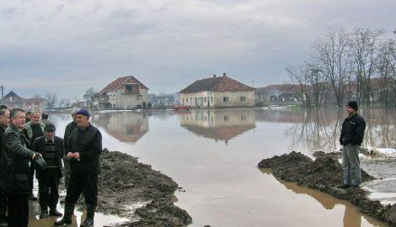
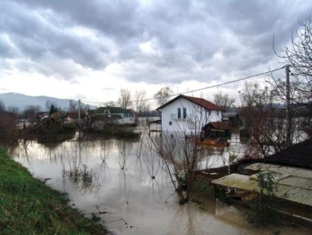
Current situation in the region
Rivers Jadar and Drina
December 2010.
Municipality Ljubovija and Loznica
Material damage over RSD 1 bil.
Flooded over 1,000 buildings
Evacuated over 5,000 people

Slide 3
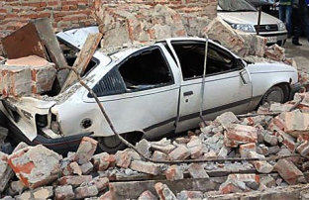
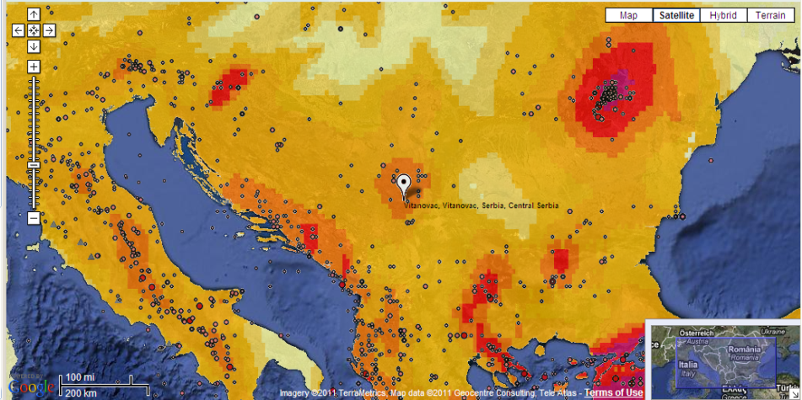
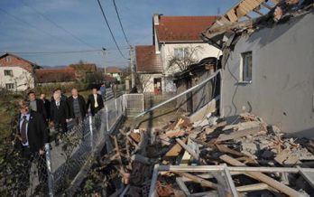
Current situation in the region
Kraljevo EQ 3rd November 2010 , 01:58h
Intensity of 5,3 Mercalli scale
EQ epicenter – village Vitanovac
Fatalities
Material damage over EUR 100 Mio

Slide 4
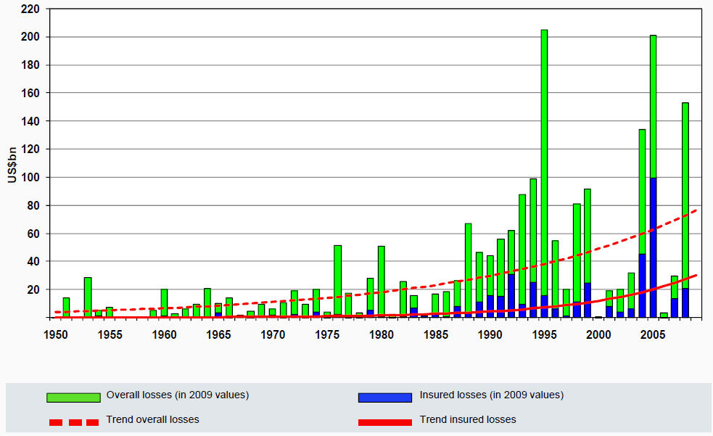
Development of economical and insured losses

Slide 5
Current situation in the region
Trend of increasing NatCat events
Better standard of living
Urban growth with high value concentration >> higher losses to be expected
Severe losses possible, if well industrialized areas are affected

Slide 6
Motivation to looking for the re/insurance solutions
Severe NatCat events could have significant impacts on national budgets
Possible collapse of entire economy
Adequate pre loss considerations have proved enormous recovery effects helping to keep downside effects as low as possible
More and more countries are looking for possibilities to improve their catastrophe management

Slide 7
Pre loss vs. post loss Government approach
Advantage:
No capital allocation necessary
Existing budget can be used for more popular projects
Disadvantage:
Lack of appropriate monetary funds in case of an event
Random distribution of money
Politically influenced indemnification, particularly in election years

Slide 8
General Pool structure
Different parties are involved:
Individuals (Customer) Insurer Indemnification of actual sustained loss net of deductible
Insurer/Pool Reinsurer/Capital market Depending on structure, a priority and a maximum limit will be applied
Government Depending on involvement, government may act as lender of last resort
Pool solution >> strong commitment of all parties involved needed

Slide 9
Pool characteristics
Premium collection
Transfer of premium to pool
Transfer of risk to pool
Commission paid to insurers as compensation for distribution efforts
Claims settlement:
Insurers manpower and expertise used for loss adjustment
Specialized loss adjusters on behalf of pool organization

Slide 10
Pool triggers: Actual loss Vs Parametric
Actual loss sustained
Advantage:
Fair
No base risk
Loss adequate indemnification, subject to capacity
Disadvantage:
Time consuming to establish the ultimate loss
High degree of administration
Parametric trigger
Advantage:
Quick compensation
Low administration (post loss)
Limited moral hazard
Disadvantage:
Based on “synthetic” trigger, irrespective of actual loss
Gauging station may not record the required amplitude, despite a significant loss elsewhere

Slide 11
Insured perils: Single NatCat perils vs. multi NatCat perils
Single NatCat peril (e.g. EQ only) Advantage:
Simple modeling and premium calculation
High transparency
Disadvantage:
No diversification
Possible anti-selection
Multy NatCat perils (e.g. EQ + Flood + Storm + etc)
Advantage:
Wide scope of cover
Increased diversification
Reduced anti-selection
Disadvantage:
Complex modeling
Lack of transparency

Slide 12
Insured objects: Buildings vs. Buildings and contents
Buildings only Advantage:
Simple modeling and premium calculation
High transparency
Disadvantage:
No diversification
Possible anti-selection
Buildings and contents
Advantage:
Comprehensive cover for private individuals
Large collective
Disadvantage:
Increased loss potential
Higher premium for individuals
Lack of interest to insure contents
Increased administration

Slide 13
Segmentation: Private Vs Commercial/Industry
Private only Advantage:
Protection of human population
High level of transparency
Disadvantage:
Limited compensation compared to overall loss
Commercial / Industry
Advantage:
Huge risk collective
High level of compensation for incurred losses
Disadvantage:
Complex modeling
Complex premium calculation
Lack of transparency

Slide 14
Romanian solution : PAID scheem
Legal frame:
Special-purpose joint stock (re)insurance company called the Pool for Insurance against Natural Disasters PAID
12 insurers as shareholder members of PAID
The maximum permissible shareholding is 15% and no insurer below 5.5%
The rights and obligations arising from the PAD shall be transferred partially or totally to multiple reinsurers of the most popular and reliable reinsurance companies and approved by the Board of Administrators
Scope of coverage:
Multiperils coverage: EQ, landslide and flood
Obligatory for residential properties in both the public and private sectors, no coverge for commercial nor industrial buildings
Homes covered t are divided into two types: Type A & Type B
Type A first loss, sum insured of EUR 20,000 and Type B EUR 10,000
Annual premium for Type A of 20 EUR and Type B premium of EUR 10.
policies are issued by PAID shareholders or need to have signed a co-operation agreement with PAID

Slide 15
Turkey solution: TCIP/DASK
Legal frame:
Turkish Catastrophe Insurance Pool (TCIP) as an independently managed fund following the Izmit earthquake in 1999 and began offering cover in September 2000.
All dwellings are required to be insured against earthquake.
is administered by a board of directors consisting of seven members including representatives from different Turkish government entity
30 insurance companies issue policies on behalf of the TCIP
Non-admitted insurers may not join the pool.
pool is placed in the international market
Scope of coverage:
Multiperils coverage: EQ inc.fire, explosion and landslide following EQ
Coverage on the first loss basis and are not subject to average clause
Obligatory for private dwellings
buildings in villages, public sector, commercial & industrial are excluded TCIP
deductible of 2% of the SI applies to e.e.l.
sum insured is fixed subject to size and type of the structure and be greater than the value of the buildings insured
sum insured is calculated as cost per m2from USD 130 to USD 750 per m2 up to USD 75,000 as absolute max

Slide 16
Serbia:
Legal frame:
Scope of coverage:
?
?

Slide 17
HVALA NA PAŽNJI Boško Petrović, generalni direktor Generali Reosiguranja Srbija

