Slide 1
A TWO-STAGE DEA MODEL TO ASSESS THE EFFICIENCY PERFORMANCE OF SERBIAN INSURANCE COMPANIES
Boris Radovanov
Aleksandra Marcikić Horvat
Dragan Stojić
Otilija Sedlak
University of Novi Sad
Faculty of Economics in Subotica

Slide 2
Introduction
In order to be prosperous in highly competitive environment insurance companies must carry out their activities efficiently.
It becomes an imperative to find a tool that will enable managers to identify the companies with the best position to respond and thrive in such conditions.
Goals:
Assess the efficiency performance of Serbian insurance companies
Check the influence of the important profitability drivers on the efficiency scores
There are few papers that pay attention to measuring efficiency of Serbian insurance companies, but none deals with a two-phase analysis, using DEA in the first, and a Tobit regression in the second.

Slide 3
DEA – methodology
Data Envelopment Analysis (DEA) is currently one of the most popular quantitative technique for efficiency analysis, where efficiency is observed as relation between selected output and input variables.
DEA is based on linear programming models.
Serbian insurance companies, will be used as Decision Making Units (DMU) in the analysis.
The results of the DEA model are relative efficiency measures.

Slide 4
Tobit regression – methodology
The second stage of DEA analysis appears to define the drivers of the technical efficiency results.
In output-oriented DEA models efficiency scores have values at the interval {0,1}.
Thus, the type of the regression for a limited dependent variable is enforced to determine the relationship between the score and relevant factors.
The main assumption of a Tobit model is to censor the dependent variable by determining the threshold of the latent dependent variable.

Slide 5
Data sample
 | Equity | Claims paid | Profit | Total premiums of insurance and reinsurance
Year 2019
Average | 1242979.30 | 2139045.10 | 1717849.00 | 4521906.05
Standard deviation | 1295928.62 | 3197255.56 | 2602990.32 | 6719545.98
Year 2018
Average | 1223099.45 | 2007279.90 | 1607059.65 | 4254388.00
Standard deviation | 1316049.25 | 3071770.82 | 2547984.68 | 6369318.87
Year 2017
Average | 1198716.86 | 1681471.62 | 1440571.90 | 3841092.29
Standard deviation | 1276480.62 | 2746728.56 | 2299647.08 | 5857105.86
Year 2016
Average | 1067782.87 | 1378967.57 | 1183896.09 | 3371402.65
Standard deviation | 1218887.41 | 2294884.58 | 1933938.94 | 5327906.06
Year 2015
Average | 1103543.63 | 1180080.00 | 1055327.96 | 2890566.71
Standard deviation | 1187331.93 | 2033921.15 | 1884242.06 | 4843385.64

Slide 6
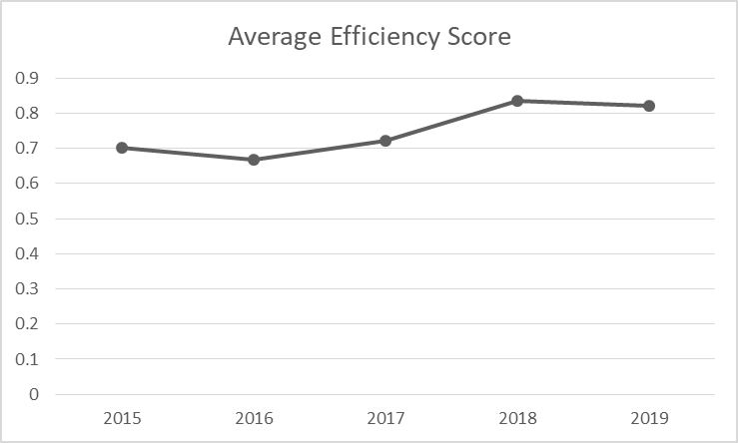
Results and discussion
The results obtained from the output-oriented DEA model with a variable return to scale.
All companies that have efficiency score less than 100% may improve achieved efficiency by increasing the level of selected outputs with the constant input level.

Slide 7
Results and discussion
DEA also provides useful information for decision makers on possible ways of efficiency improvement for inefficient insurance companies.
DMU | Benchmark(Lambda)
DDOR Novi Sad | AMS(0.005990); Dunav insurance(0.292718); Generali insurance(0.333194); OTP insurance(0.368098)
Globus insurance | Dunav insurance(0.006785); OTP insurance(0.993215)
Grawe insurance | Dunav insurance(0.135133); OTP insurance(0.864867)
Merkur insurance | Dunav insurance(0.003454); Generali insurance(0.015547); OTP insurance(0.980999)
Table shows the peer groups for inefficient companies and the corresponding values of lambda.
Peer groups are the set of efficient DMUs from which an inefficient unit’s should learn how to improve its allocation of inputs and outputs.

Slide 8
Results and discussion
DMU | Proportionate Movement (Equity) | Proportionate Movement (Claims paid) | Proportionate Movement (Profit) | Proportionate Movement (Premiums)
DDOR Novi Sad | 0.00 | 0.00 | 883658.13 | 2275891.76
Globus insurance | 0.00 | 0.00 | 200499.39 | 583195.92
Grawe insurance | 0.00 | 0.00 | 10785.75 | 100503.34
Merkur insurance | 0.00 | 0.00 | 44337.07 | 302901.43
Table presents proportionate movements of input and output variables
Since selected DEA model is output oriented, proportionate movements of output variables show necessary increase of the output levels in order to achieve the highest efficiency score.

Slide 9
Results and discussion
It is important to report that both the scores of technical efficiency and any non-zero input and output slacks to provide an accurate indication of technical efficiency of a unit in a DEA analysis.
DMU | Slack Movement (Equity) | Slack Movement (Claims paid) | Slack Movement (Profit) | Slack Movement (Premiums)
DDOR Novi Sad | 0.00 | 0.00 | 0.00 | 0.00
Globus insurance | -66397.05 | 0.00 | 148578.30 | 0.00
Grawe insurance | -29811.45 | 0.00 | 1233457.92 | 0.00
Merkur insurance | 0.00 | 0.00 | 352991.13 | 0.00
Slacks are only the leftover portions of inefficiencies, after proportional reductions in inputs or outputs.

Slide 10
Results and discussion
Variable | Coefficient | z-Statistic
Constant | 0.50672*** | 6.71953
ROE | 0.03464*** | 2.66185
ROA | 0.06173** | 2.18916
Total investments | 0.000000012** | 2.21622
Loss ratio | -0.13882** | -2.05861
Expense ratio | -0.34806*** | -2.86719
Table exhibits the estimation results of the Tobit model applying a random effects form of the model and backword variable selection procedure.

Slide 11
Results and discussion
Higher profitability leads to higher relative efficiency of insurance companies.
The more investment opportunities the company has, the more efficient it is.
Companies with a high solvency and safety level on average recieve greater efficiency scores.
Thank you for your attention!

