Slide 1
Validation of third-party Catastrophe loss models
Stefano Ellero
XVII INTERNATIONAL SYMPOSIUM
INSURANCE AT THE THRESHOLD OF THE FOURTH INDUSTRIAL REVOLUTION
Zlatibor, hotel „Mona“, May 16-19, 2019

Slide 2
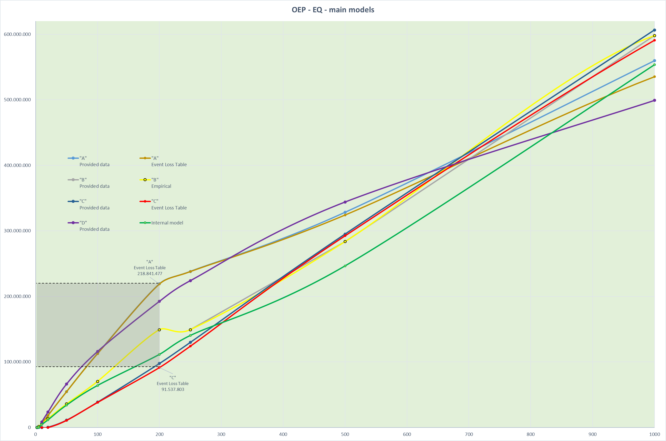

Slide 3




CAT LOSS MODELLING
Cat risks and their management are a sort of myth…unclear calculations, different language (Cat losses, Return Periods, Aggregate vs. Occurence distributions, Secondary Uncertainty, etc…);
Nevertheless, as for any other traditional business, just one info is crucial: the amount of losses next year;
S2
Standard Formula
Internal
Loss Model
Third-party
Loss Models
Info requested
TSI current portfolio data
(by Cresta zones, by LoB)
All historical portfolio data (Losses, TSI, Premiums);
Historical catalogue of Cat events (National archive)
Any other Peril info tied to the historical events (EQ magnitude, Hailstone size, etc.)
TSI current portfolio data
(by: Cresta zones, Construction Type, Year of Built, Type of business – RES/COM/IND, Number of storeys, Object Insured – BUILDING/CONTENTS/BI, etc.)
How it works
Specific coefficients are applied to each TSI /Cresta/LoB combination
Coefficients are provided by EIOPA
Deterministic assessment thought as the VaR@99,5% (Return Period = 200 yrs);
E.g. Hail:
  Losses/TSI → historical Damage Ratio;
  Event catalogue → hailstone size + radius
  Correlation Damage Ratio vs. Hailstone size
  Hailstone size distribution → Identification of RP=100/200/500/1000
  Calculation of the corresponding Damage Ratio
  Application at the desired portfolio (TSI)
Portfolio dataset is ususally provided to brokers → RMS, AIR, SwissRe, MunichRe, et al. Models are run
Home renewal
Painting the walls and fixing minor bugs (˝it‘s done˝)
Full renewal alone (˝huge effort and energy, excellent result˝)
Ask for a construction team/firm (and cross the fingers)

Slide 4
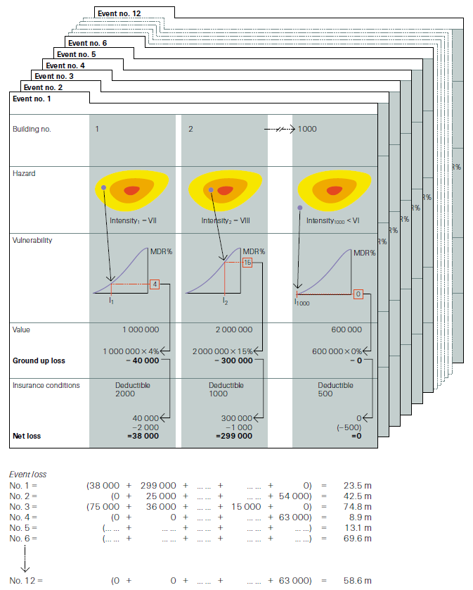

Slide 5
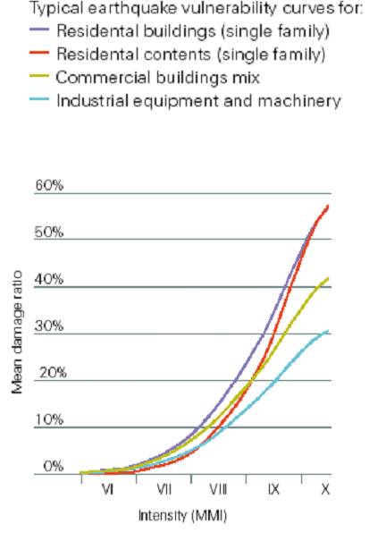

Slide 6
Loss Model selection – Areas of impact
RI setting / optimization
Capital analysis Gross/Net
Underwriting (analysis of the impact of a single risk)

Slide 7

Loss Model selection – Key drivers to ˝validate˝it
Comparison with S2 Standard Formula
RoL ≈ 1% for the highest layer of the RI programme
Sensitivity analysis
(model‘s reaction changing some inputs)
Backtesting (comparison with real data)
Comparison with the Internal Model (existing and reliable)
…

