Slide 1
Technology Transfer for Climate Resilient Flood Management in Vrbas River Basin WILLINGNESS OF HOUSEHOLDS IN BOSNIA AND HERZEGOVINA TO PAY FOR INSURANCE COVERAGE AGAINST NATURAL DISASTERS Safet Kozarević PhD, Faculty of Economics, University of Tuzla Jovanka Ćetković M.Sc., United Nations Development Programme BiH Raduška Cupać MA, United Nations Development Programme BiH Zlatibor, 17 May, 2019

Slide 2
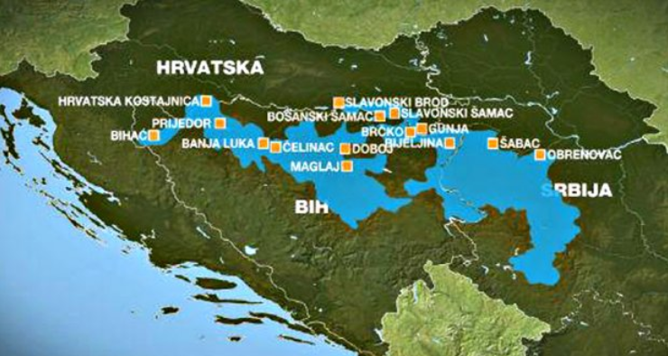
Floods in the Balkans 2014

Slide 3
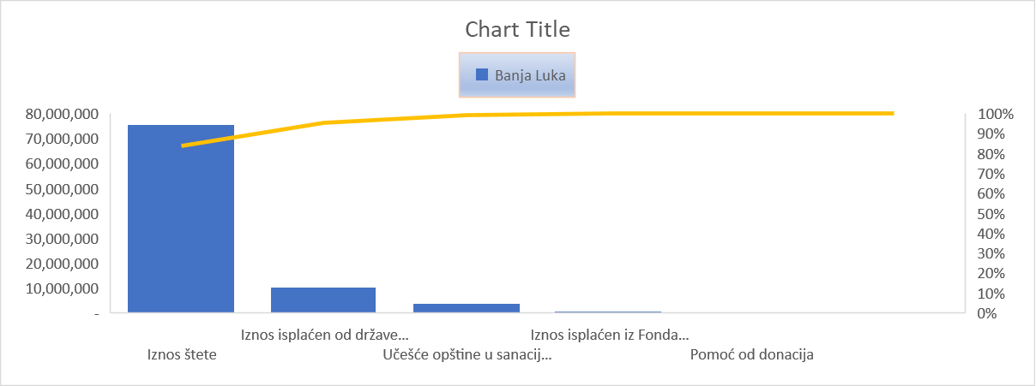
May 2014.– extreme floods and the highest water levels:
Serbia: 1,106 billion EUR
Croatia: 297,6 mil. EUR
Bulgaria: 311,3 mil. EUR
B&H: 1.02 billion EUR in Federation B&H and 965 mil. EUR in the Republic of Srpska
B&H floods caused damage to 15% of GDP.
The most affected sectors in B&H according to the EU Commission:
Economy: EUR 790 m
Transport and Communications: EUR 346 m
Agriculture: EUR 186 m
Bosnia and Herzegovina in 2014
Droughts - 2000, 2003, 2011, 2012.
Floods- 2002, 2004, 2006, 2009, 2010, 2013, 2014,2017, 2018, 2019.
Notes:
In 2014, budget reserves, even after the budget rebalance, covered flood damage in the amount of:
- 0.5% in the Federation of B&H,
- 0.16% in Republika Srpska.
2014, insurance companies paid a total of 24.78 million KM flood insurance, which is only 1.31% of the total estimated economic flood losses.
At the donors' conference in Brussels in July 2014, the amount of 1.580.472.698,85 BAM was promised, of which 83% loans and 17% donations.
Out of these funds, by March 2016 only 37.5% was disbursed, which is approximately 14.9% of the total estimated losses at the level of B&H

Slide 4
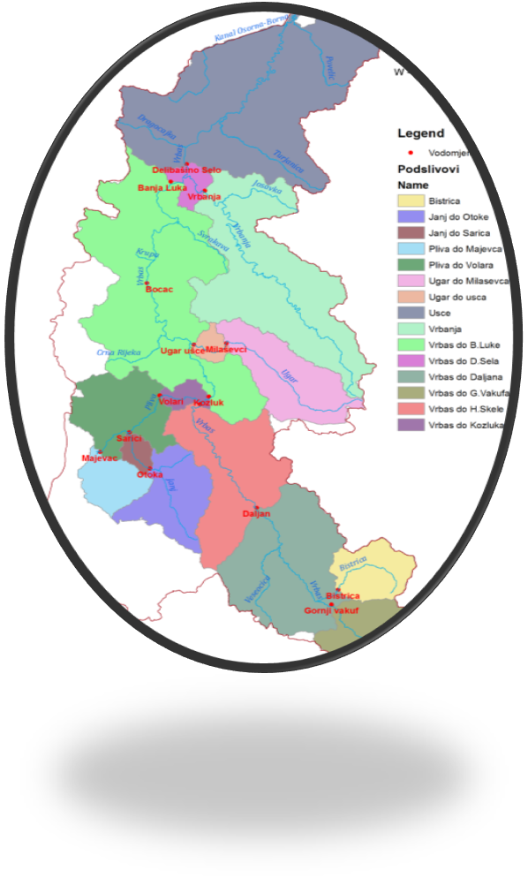
Flood/disaster risk reduction in BiH
The following has been done under the Project:
Flood hazard and flood risk maps developed.
EU flood Directive transposition completed;
Flood Forecasting and Early Warning System
GIS loss/damage model developed; Torrents register with erosion map;
Non-structural flood risk mngmt. measures - incl. insurance
-

Slide 5
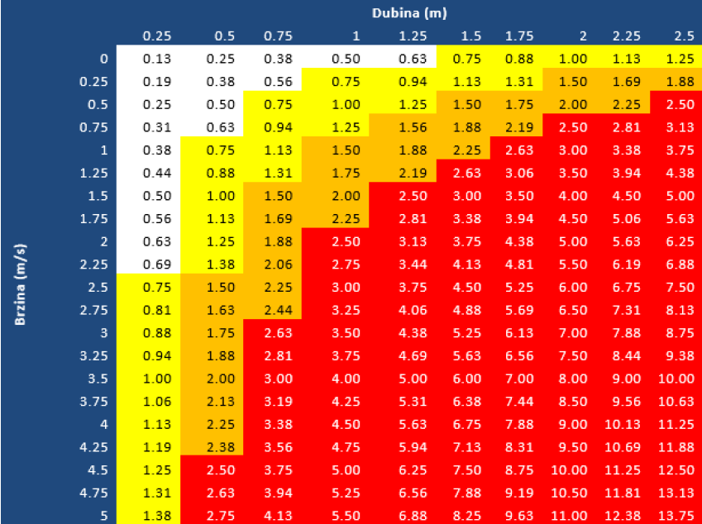
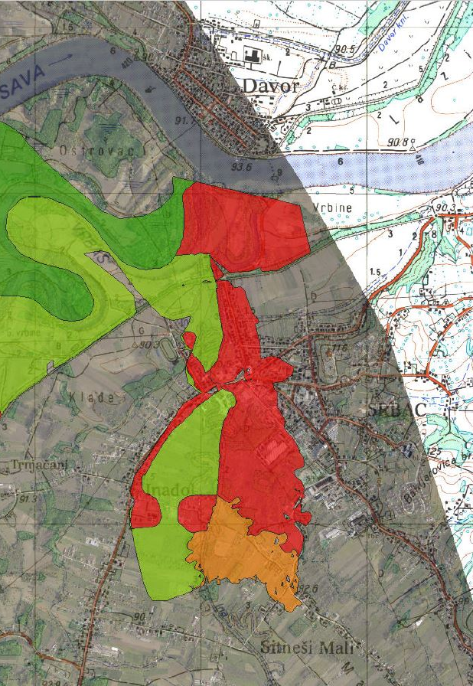
Introduction of financial instruments i.e. Flood insurance included: Analysis of the insurance sector in BIH; Overview of current practices and techniques for risk management and financing models; Overview of the institutional and legal framework in the insurance market in BiH; Overview of insurance in countries in the region, and comparison with developed countries; Feasibility study; - Development of GIS-based index/indemnity based insurance models and insurance schemes for BiH, - Calculated insurance tariffs in accordance with flood hazard and risk maps, etc. -

Slide 6
Example: Indemnity based property insurance tariffs
................no differentiated as per construction type
Classes | Gross premium rate %
Class 0 | 2,17
Negl. risk
Class 1 | 3,18
Low risk
Class 2 | 6,48
Moderate risk
Class 3 | 18,50
Extreme risk
Class 0
SO = 10000
P = 10000 x 2,17/1000 = 21,7 KM
Class 1
SO = 10000
P = 10000 x 3,18/1000 = 31,8 KM
Class 2
SO = 10000
P = 10000 x 6,48/1000 = 64,8 KM
Class 3
SO = 10000
P = 10000 x 18,50/1000 = 185,0 KM

Slide 7
Total number of housing units: - BiH 1.617.308 out of which: - Federation of BiH 991.384 - Republic of Srpska 588.241 - Brčko district BiH 37.683
First risk limit of 30.000 KM per housing unit - total exposure is
48.519.240.000 KM
Source: BosnaRE
Notes:
Pretpostavke. Uz limit na prvi rizik od 30.000 KM po stambenoj jedinici ukupna izloženost je
48.519.240.000 KM

Slide 8
Awareness RS INSURANCE ASSOCIATION
Source: AZO RS

Slide 9
Therefore,
In order to prepare the local communities, citizens, business subjects and agricultural producers to manage the flood risks through transfer and adaptation of technologies, focusing on selection of adequate method for risks funding the Project took the “Willingness to pay for natural disasters insurance scheme in Bosnia and Herzegovina”,
In that context, in order to prepare adequate insurance products, it was necessary to consider other natural disasters’ risks in addition to floods such as landslides, earthquakes.

Slide 10
The objective of the Study was to test and work on introduction of flood/natural disasters insurance including a detailed survey on willingness to pay for flood/natural disasters insurance scheme in BiH including potential insurance package product.
Four market segments have been identified (households, public institutions, business subjects and agricultural producers
Three risks were considered: floods, landslides and earthquakes

Slide 11
SAMPLE AND METHODOLOGY
Respondents’ sample (2500) : the entity, river basin and municipality level of exposure
The concept of the insurance product : insurance package that could be introduced (reliability, insurance premium and the insured amount).

Slide 12
Feature/Modalities | Freq. | %
Location of house/apartment
Urban settlement | 248 | 24.8
Suburban settlement | 305 | 30.6
Rural settlement/village | 445 | 44.6
Total | 998 | 100.0
Type of residential building/house
House | 833 | 83.6
Apartment | 163 | 16.4
Total | 996 | 100.0
Gender
Male | 736 | 73.8
Female | 261 | 26.2
Total | 997 | 100.0
The highest educational degree of the head of household
Elementary school | 205 | 20.9
High school degree | 588 | 59.9
Associate degree | 89 | 9.1
University degree and higher | 100 | 10.2
Total | 982 | 100.0
Average monthly household income
to 500 KM | 347 | 35.5
500-999 KM | 266 | 27.2
1000-1499 KM | 163 | 16.7
1500-1999 KM | 103 | 10.5
2000 KM and more | 98 | 10.0
Total | 977 | 100.0
Table 1. Socio-economic features of households

Slide 13
Age of head of household
<= 53 | 256 | 26.1
54 – 62 | 244 | 24.9
63 – 70 | 253 | 25.8
71+ | 227 | 23.2
Total | 980 | 100.0
Number of household members
1 | 136 | 13.8
2 | 260 | 26.4
3 | 204 | 20.8
4 | 202 | 20.5
5+ | 181 | 18.4
Total | 983 | 100.0
Entity
FBiH | 619 | 61.6
RS | 386 | 38.4
Total | 1005 | 100.0
Basin
Bosna | 442 | 44.0
Korana/Glina | 33 | 3.3
Neretva | 103 | 10.2
Sava/Drina | 54 | 5.4
Trebišnjica | 17 | 1.7
Ukrina | 33 | 3.3
Una | 137 | 13.6
Vrbas | 186 | 18.5
Total | 1005 | 100.0
Table 1. Socio-economic features of households (cont.)

Slide 14
Identifying households needs for Insurance against ND
The dimensions of the need for insurance against the natural disasters covered relate to:
the respondents experience of such damage,
their awareness in terms of their level of exposure to the risks posed by natural disasters,
willingness to insure their house/apartment/residential building against natural disasters,
their willingness to purchase commercial insurance products to cover their assets and
their inclination toward risk retention.

Slide 15
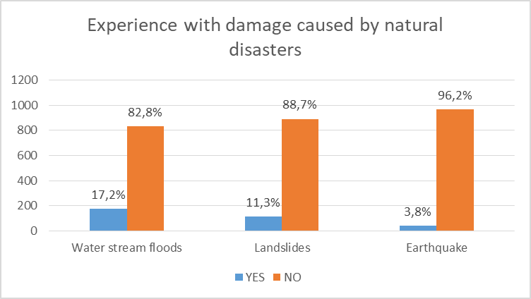

Slide 16
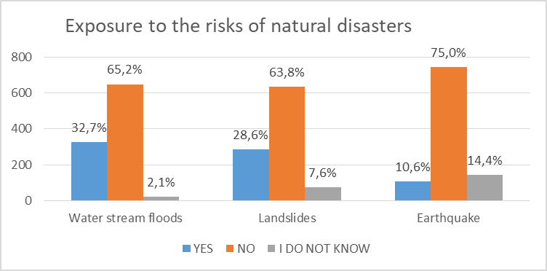

Slide 17
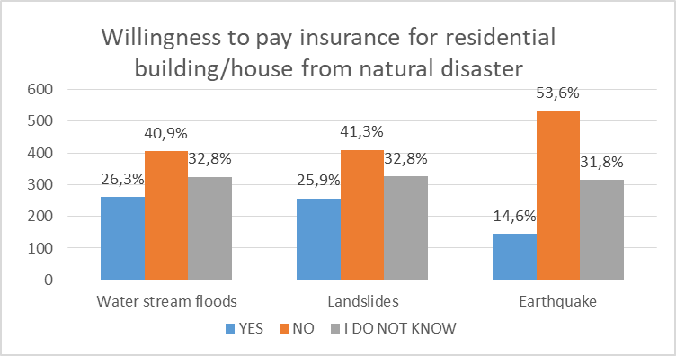

Slide 18
Financial aspects of natural disasters for households

Slide 19
Damage financing expectations

Slide 20
Concept of natural disasters’ insurance product –for households Attitudes toward mandatory insurance

Slide 21
Conclusions and Recommendations as results of the Study
All assessed segments (households, public institutions, business subjects, agricultural producers) have relatively high needs for natural disasters’ insurance considering the situation and level of development of insurance market in BiH.
There is a significant potential for development of natural disasters’ insurance package for all four assessed segments.

Slide 22
High percentage of respondents is not inclined to the risk retention in all assessed segments, which represent a potential for change of their attitude and behaviour towards the insurance from natural disasters.
The respondents have positive attitude to introduction of mandatory insurance for assessed disasters (lower price compared to the commercial one).

Slide 23
Conclusions and Recommendations as results of the Study
Creating awareness - campaigns
Development of natural disasters’ insurance product (floods, landslides, earthquakes)
Regulatory framework –for mandatory insurance
New Product models- with fixed and variable premiums; implemented through the synchronised engagement of the relevant state institutions, insurers and reinsurers, financial institutions as well as capital market institutions, etc.

Slide 24
Thank you for attention Jovanka Ćetković jovanka.cetkovic@undp.org www.ba.undp.org

