Slide 1
Modeling Financial Flows of Insurance Company Based on Machine Learning
International Actuarial Advisory Company
Valeriy Baskakov, Ph.D. (Dr. Sci. (Math.)), Professor
Nikolay sheparnev
EUGENIE YANENKO

Slide 2
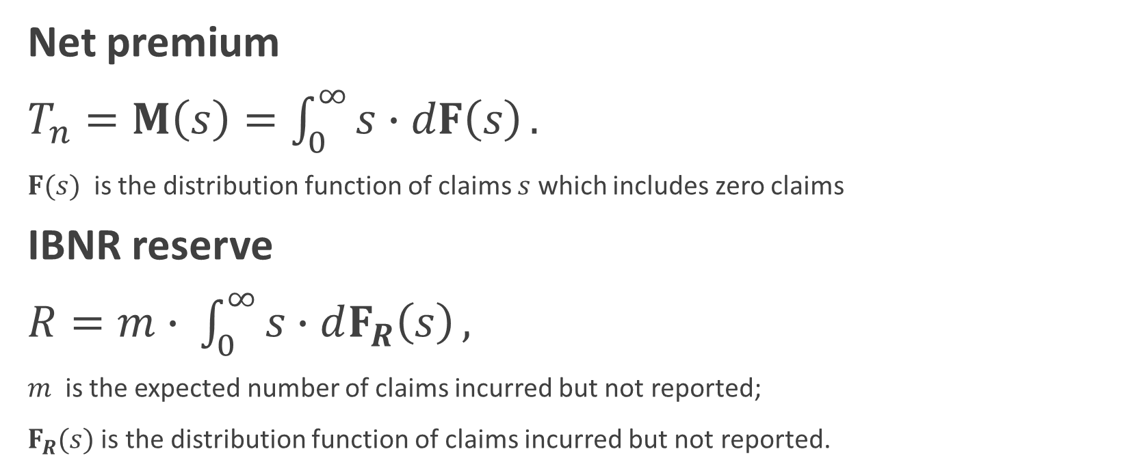
The Financial Indicators
Net premium
$T_{n}=M\left(s\right)=\int_{0}^{∞}{s∙dF\left(s\right)}.$
$F(s)$ is the distribution function of claims $s$ which includes zero claims
IBNR reserve
$R=m∙ \int_{0}^{∞}{s∙dF_{R}\left(s\right)},$
$m$ is the expected number of claims incurred but not reported;
$F_{R}(s)$ is the distribution function of claims incurred but not reported.

Slide 3
Objective of the Study
Design of methods of distributions statistical assessment to model financial flows of insurance companies, based on the data of the Registers of Claims and the Registers of Insurance Policies, including policies with deductibles.
Applying proposed methods to the data of Russian insurance companies.
Assessment of estimation accuracy using statistical modelling method.

Slide 4
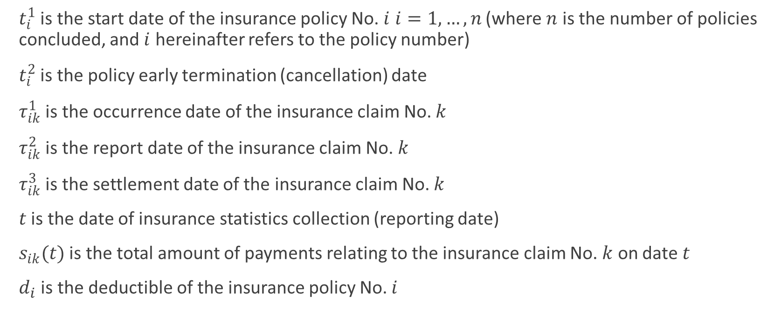
Statistical Data
$t_{i}^{1}$ is the start date of the insurance policy No. $i$ $i=1, …,n$ (where $n$ is the number of policies concluded, and $i$ hereinafter refers to the policy number)
$t_{i}^{2}$ is the policy early termination (cancellation) date
$τ_{ik}^{1}$ is the occurrence date of the insurance claim No. $k$
$τ_{ik}^{2}$ is the report date of the insurance claim No. $k$
$τ_{ik}^{3}$ is the settlement date of the insurance claim No. $k$
$t$ is the date of insurance statistics collection (reporting date)
$s_{ik}(t)$ is the total amount of payments relating to the insurance claim No. $k$ on date $t$
$d_{i}$ is the deductible of the insurance policy No. $i$

Slide 5
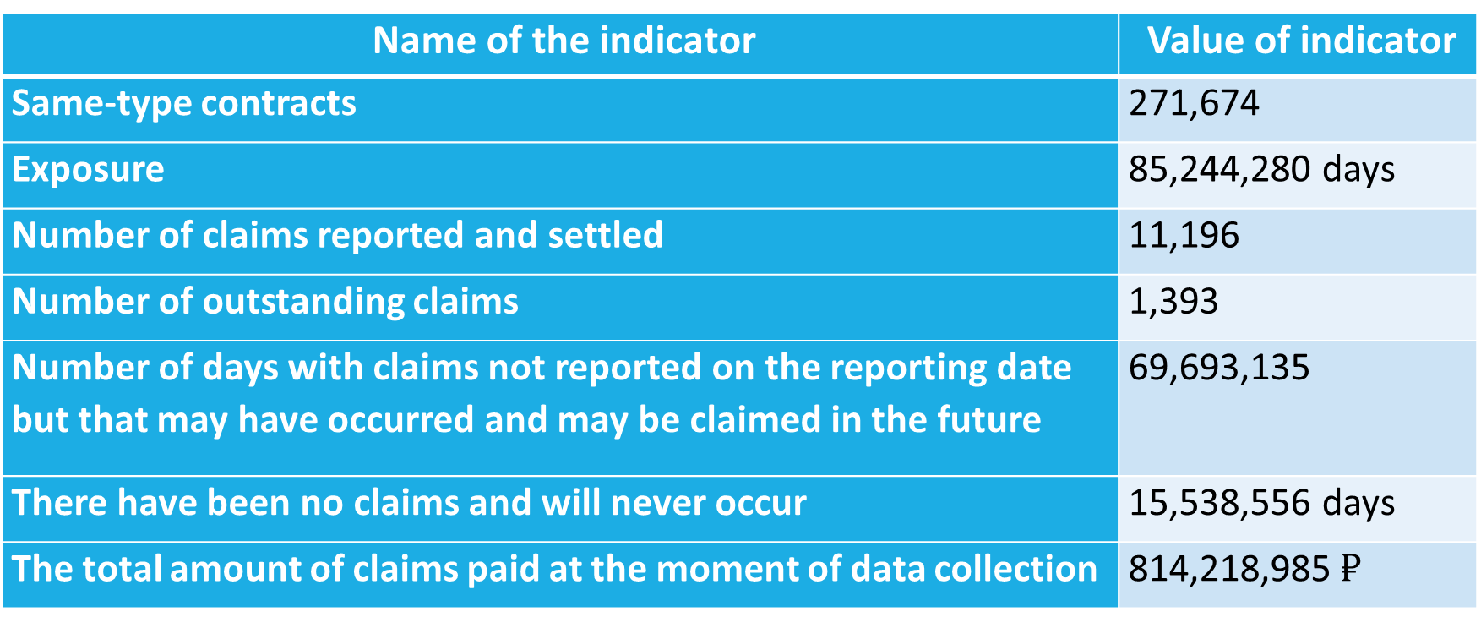
The real data of Russian general insurance companies
Name of the indicator | Value of indicator
Same-type contracts | 271,674
Exposure | 85,244,280 days
Number of claims reported and settled | 11,196
Number of outstanding claims | 1,393
Number of days with claims not reported on the reporting date but that may have occurred and may be claimed in the future | 69,693,135
There have been no claims and will never occur | 15,538,556 days
The total amount of claims paid at the moment of data collection | 814,218,985 $₽$

Slide 6
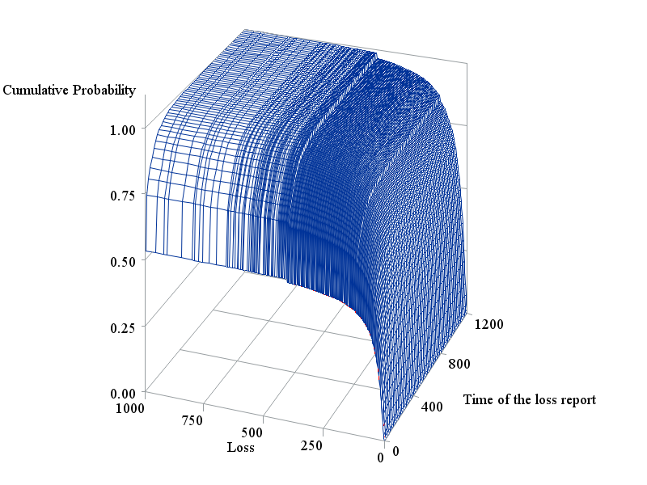
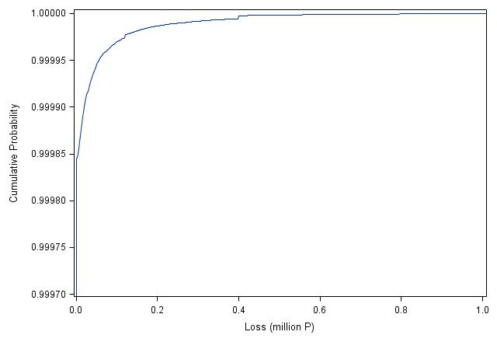
Estimate of the distribution function
two-dimensional distribution function $F(s,τ|τ<∞)$
marginal distribution function $F(s)$

Slide 7
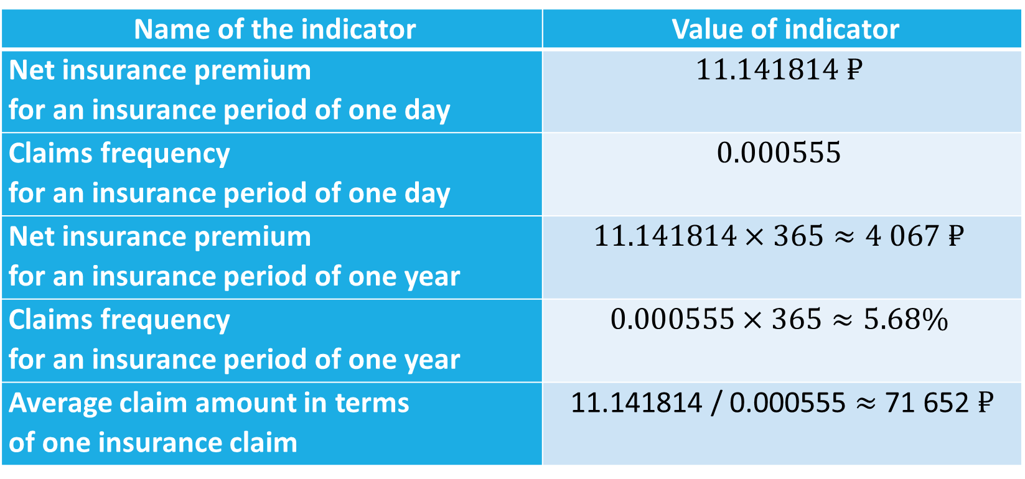
Calculation results
Name of the indicator | Value of indicator
Net insurance premium for an insurance period of one day | $$11.141814 ₽$$
Claims frequency for an insurance period of one day | $$0.000555$$
Net insurance premium for an insurance period of one year | $$11.141814×365≈4 067 ₽$$
Claims frequency for an insurance period of one year | $$0.000555×365≈5.68\%$$
Average claim amount in terms of one insurance claim | 11.141814 / 0.000555 $≈$ 71 652 $₽$

Slide 8
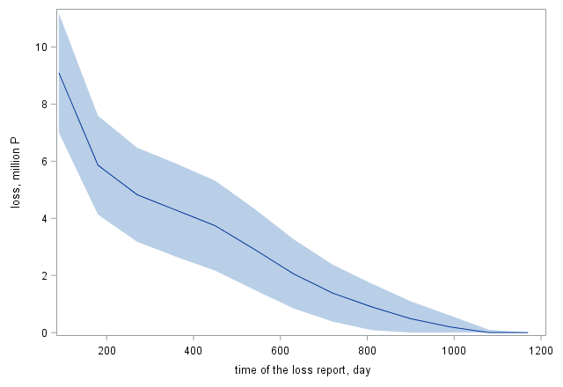

Claims reserves
Claims reserves:
$11.141814×85,244,280−814,218,985≈135.6 \text{million} ₽$
Alternative estimate
The chain-ladder method 126.0 million $₽$
Frequency&Severity 116.7 million $₽$
Bornhuetter-Ferguson method 147.6 million $₽$
IBNR:
$35,759,781 ₽±4,057,684 ₽$
Outstanding claims reserves:
$135,556,927−35,759,781=99,797,146 ₽$
Distribution of IBNR over time

Slide 9
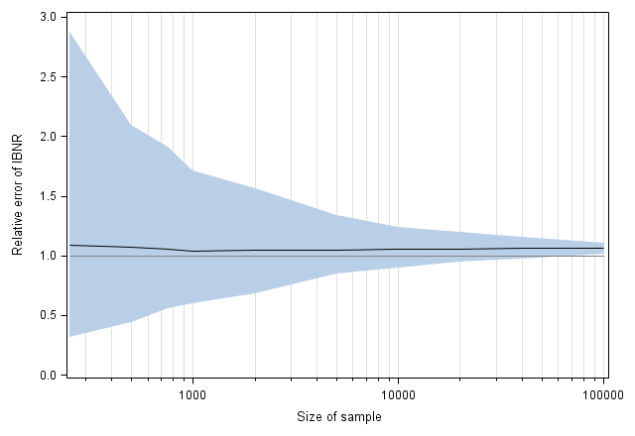
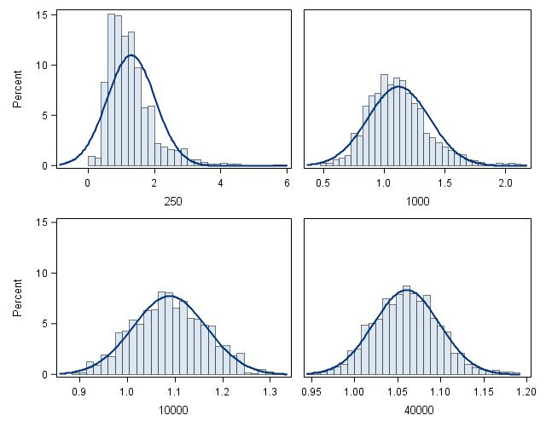
Estimation accuracy
IBNR percentage error depending on sample size
Distribution density of IBNR normalized value

Slide 10
Thank you for your attention!
International Actuarial Advisory Company Llc
3A, 1-st Khoroshevskiy pr., 125284, Russia
Web.: www.IAAC.ru
E-mail chief@actuaries.ru
tel.: +7 903 100 2660

