Slide 1
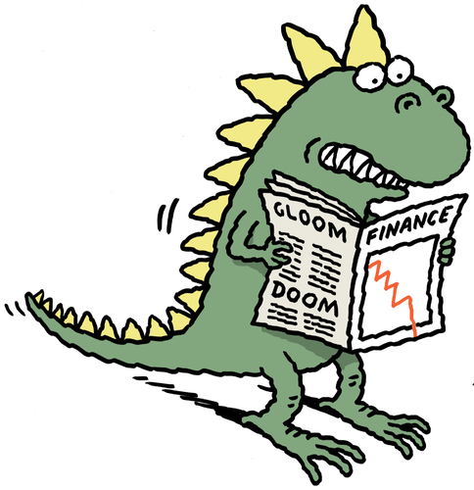
REASSESSING INSURANCE BUSINESS MODEL – EVOLVE OR GET EXTINCT
Nikola Rodic
OTP Osiguranje

Slide 2
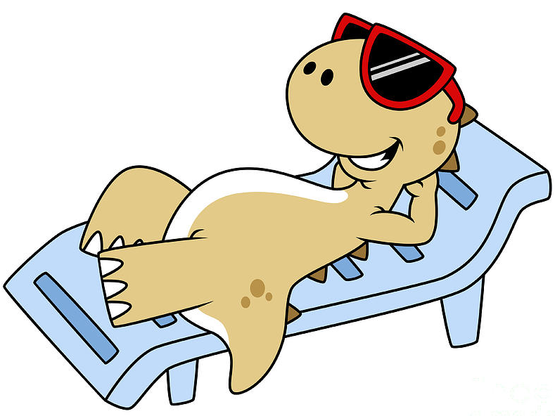
WHY THE URGENCY?
It is hard to stay on top (i.e. Fortune 500)
Can we as insurers earn cost of capital (CoC)? In North America and Western Europe the answer is NO
And in Serbia?
  Non-life earns minimal CoC and regional CoC
  Life barely earns its minimal CoC, while regional CoC is out of reach
If we are not able to earn your CoC we are destroying value

Slide 3

SECULAR TRENDS THAT ARE SHAPING OUR FUTURE
A lot of reports and analysis on trends to choose from
McKinsey Global Insurance Report 2022 chosen as a starting point
Every of these 8 global secular trends explained first
Then localize them and identify their effects on the Serbian insurance industry

Slide 4

DECOUPLING OF MACROECONOMIC
ENVIRONMENTS
Divergence in world economies: different level of interest rates and inflation and increased geopolitical tensions
Monetary policy tightening in advanced economies (differing levels of interest rates in Europe and US)
Move from a hyper global world to the one that is more local and compartmentalized started before the pandemic
Serbia exposed to decoupling in a similar way as Europe in general:
  Low interest rates
  Increase in inflation
  Re-shoring and near-shoring
  Loss of some foreign markets

Slide 5
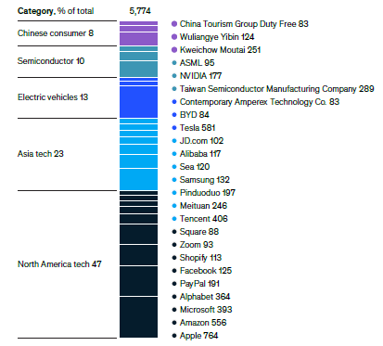

DICHOTOMY BETWEEN WINNERS AND LOSERS
Winner takes all
Rise of Big tech companies
Big tech to start entering the insurance value chain
Insurance is not a high concentration industry
Insurers are not just competing with other insurers but possibly with Big tech
We shouldn’t forget that even locally we will possibly compete with Big tech

Slide 6

POTENTIAL ANCHORING OF REMOTE-INTERACTION
MODELS WITH CUSTOMERS
We have been accustomed to great customer experience in e-comerce and now expand these expectations to insurance
Customers expect to be able to use on-line and off-line communication channels without glitches
Insurance industry and insurtech are joining forces to improve customer journeys
In Serbia we can see that digital offer is still rather basic
Local insurance companies are not sitting idle and are very much focused on digital

Slide 7
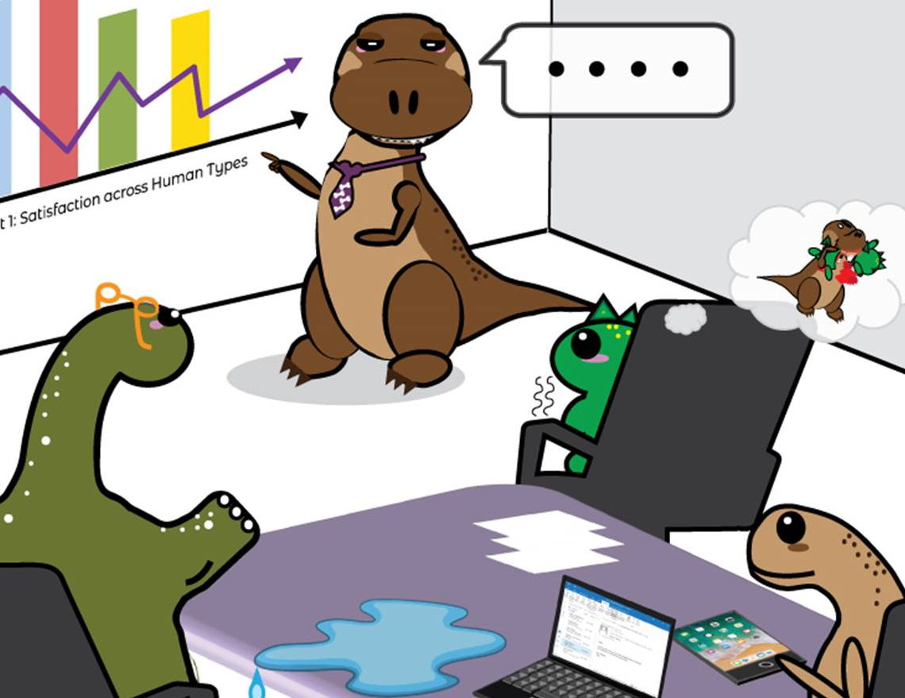
INCREASED AWARENESS OF SUSTAINABILITY, CLIMATE CHANGE, AND ISSUES OF DIVERSITY, EQUITY, AND INCLUSION
ESG or taking environmental, social and governance considerations into account when making investment decisions
Example: focus on gender inequality – globally share of women just 29% of top management in insurance (28% in Serbia)
But one shouldn’t treat ESG just as compliance exercise
Serbian insurance market is still not focused on ESG
  More prominent in the near future
  First as a compliance requirement by group HQ
  Then moving to real focus

Slide 8
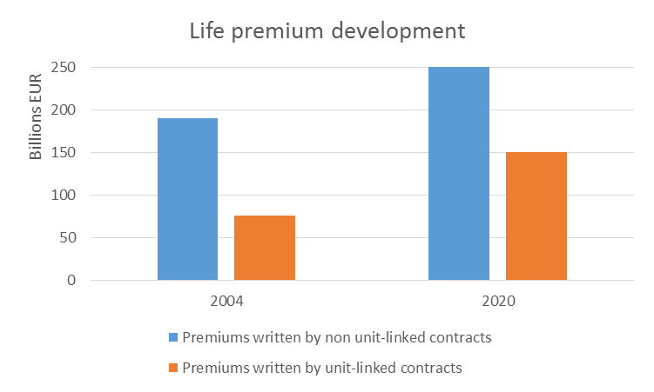

NEW CHALLENGES TO THE PURPOSE AND RELEVANCE OF INSURERS
Low interest rates pressure life insurance – move to UL – other financial institutions can offer similar products
Pricing pressures driven by fee transparency – price reduction – insurers can expand risk coverage
Organic demand growing slowly in mature markets – price increases and additional benefits
Serbia is still behind the most advanced markets
  Redeveloping life products but still not entering the UL in a big way
  Price transparency is still not a burning issue
  Adding non-insurance benefits

Slide 9
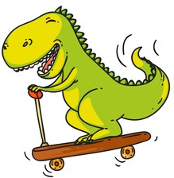
RETHINKING OF MOBILITY
Covid-19 lockdown had an especially large effect on mobility
Insurance industry is addapting and developing tailor made solutions
Big changes in the auto-manufacturing industry – balance of personal to commercial premiums to shift from 80/20 today to 40/60 by 2040
In Serbia catchup with mobility trends will start from MTPL liberalization (remember the Croatian exerience)
Then insuring e-scooters and fleet coverage (global programs)
Increased coverage of car hailing platforms

Slide 10

RENEWED FOCUS ON HEALTH AND WELL-BEING
Customers accustomed to use medical service on-line via telemedicine and health wearables
People are now more hooked on home nesting – enter home insurance and assistance services
Serbian insurers are following these trends and thinking of ways to increase their offering – additional on-line services, health apps, home assistance services...

Slide 11
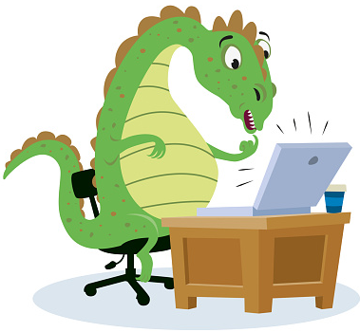
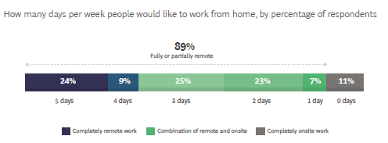
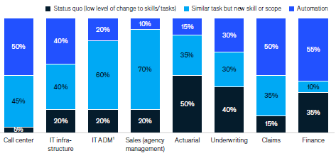
DAWN OF NEW WAYS OF WORKING
9 out of 10 people would like to work at least some time from home
Shift to new way of working that is more automated but with a changed scope (higher cognitive, social and technical skills)
Attracting top talent having in mind that the skill mix requirements are increasing
Serbian insurance sector is also adapting to the new ways of working

Slide 12

ARE WE GOING TO END UP LIKE BIRDS
OR BRONTOSAURUSES?
There is an interesting story that birds are descended for dinosaurs and that they were able to adapt to the new environment after the meteor struck and wiped brontosauruses for example
As an industry we should keep looking at the big picture and preparing for secular trends to come
We should not just concentrate on the short-term
The best ones to adapt will take most of the rewards AND FLY
The ones that refuse to change will get extinct
It is up to every one of us do decide our own path to success

Slide 13
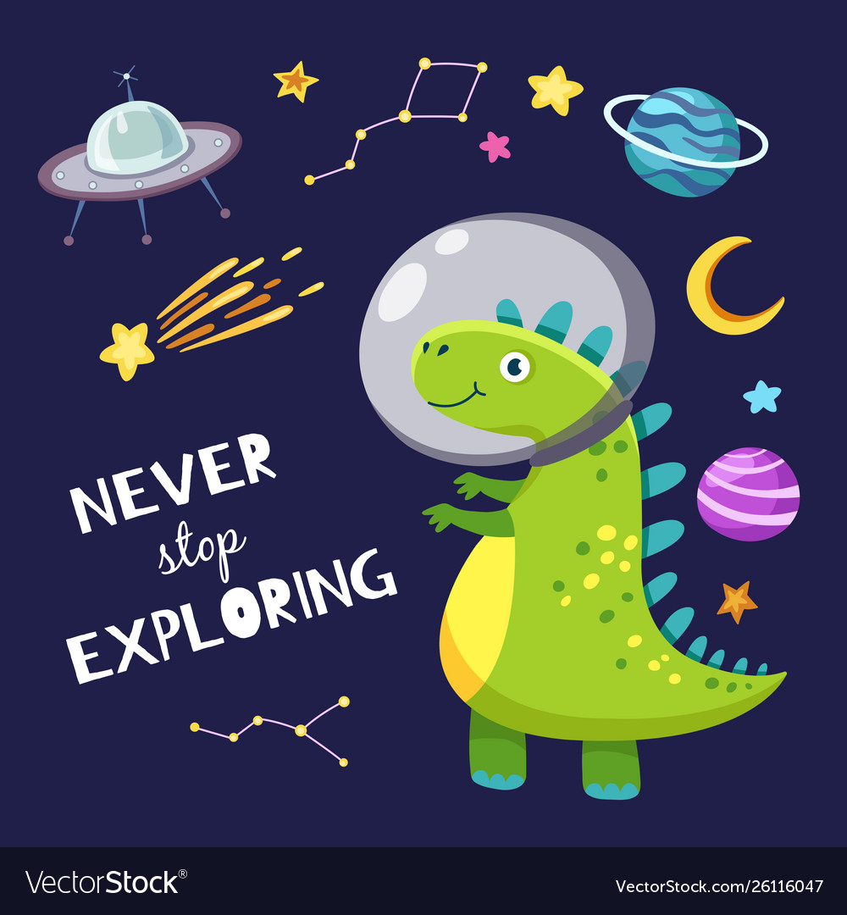
Thank you for your attention
nikola.rodic@otposiguranje.rs

