Slide 1
XXII MEĐUNARODNI SIMPOZIJUM
TRANSFORMACIJA TRŽIŠTA OSIGURANJA – ODGOVORI NA NOVE IZAZOVE
Generative AI and Insurance
Prof. Branko Urošević (RAF) and Sergej Šaletić, MSc (FIS)

Slide 2
About Generative AI
Large language and image generation models that use deep learning and transformer techniques to model high-dimensional probability distributions of language, images or videos.
Latent high-dimensional semantic space of language or images mapped to multimedia representations of text, audio, or video.

Slide 3
About Generative AI
Different input formats mapped into various output formats. Useful in many applications, including insurance.
Due to the probabilistic nature of these models, the same requests may generate different outputs.
This can lead to “hallucinations”. E.g., a “realistic painting of a human” generated by AI can have three legs.

Slide 4
Types of generative AI systems by final output (Gozalo-Brizuela R. and Garrido-Merchan (2023))
Example: Generation of text
Generation of
Text
Images
Videos
3D models
Audio
Code and software
Text
Image
Text
Audio
Video

Slide 5
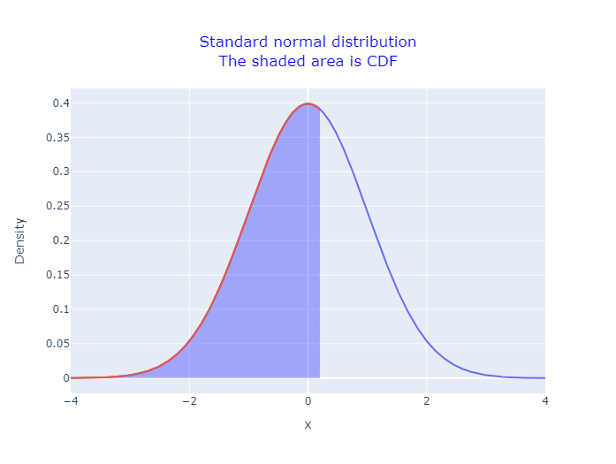
Using ChatGPT to generate code illustrating CDF of the standard normal variable
“Create a code in Python using Plotly library that would present density function of the standard normal distribution. Shade the area to the left of the value 0.2. In the first line of the title should read: Standard normal distribution. In the second line should say: The shaded area is CDF. Both lines in the title should be centered and in blue. Please do not place any legends.”

Slide 6
Collection and usage of data

Slide 7
Data augmentation
  Enabling insurers to collect, organize and augment data more efficiently
  Creating synthetic data from the existing data
  Imitate the features of the original datasets without personally sensitive info
  USE CASES
  Filling gaps in data
  Synthetic images of damaged properties or cars based on the existing images, eye-witness testimonies etc
  CHALLENGES
  Ensuring veracity
  Low variability of outputs when AI generated data used for further training

Slide 8
Data analysis and insights
  Insight from unstructured data sources – text documents, emails, images, voice conversations, videos, news articles or social media posts
  Identifying key sentiments, patterns, trends and/or correlations
  EXAMPLE:
  Allstate Insurance combines usage of drones and AI to recognize and determine losses from aerial images

Slide 9
Claims processing
  EXAMPLE: Ageas (UK) . Full automation using insurtech Tractable
  CHALLENGES:
  Sometimes, human touch and experience is needed. Faster is not always better or more accurate.
Loss
notification
Loss
estimation
Loss
payout

Slide 10
Reducing cost of real data collection (maybe)
  GEN AI can reduce the need for expensive real data collection
  ⚠ Recall that Gen AI does not always generate data corresponding to reality (the so-called hallucations of the gen AI systems)
  ⚠ Creating data based on AI generated data reduces variability and accuracy.
  Thus, we certainly cannot stop collecting real data.

Slide 11
Content creation and personalization

Slide 12
Content creation and personalization
  MARKETING CONTENT CREATION
  Chinese insurance company Zhong: using Gen AI, from one poster image for insurance products in three days, to multiple sets of different styles of posters in a couple of hours.
  CREATING POLICY DOCS
  Generating personalized comprehensive policy documents
  CREATING TRAINING MATERIALS AND BOTS
  Company Training Bot offers customizable training bots. Input is the company data, output is step-by-step employee training and guidance.

Slide 13
Customer behavior analysis
  STRAIGHT FROM THE WORLD OF GEORGE ORWELL AND PHILLIP K. DICK
  Combining AI & Internet of Things (IoT) to follow customers’ lifestyle, fitness and driving habits. Helps offering highly customized products, may reduce churn.
  Offering wearables, e.g. fitness watches, together with health insurance policies or discounts on gym memberships.
  Use customer health data to monitor their lifestyle and provide advice on healthy lifestyle or create dynamically changing premium based on health markers
  Can be used for good or bad, obviously

Slide 14
Improving risk models and decision-making
  Tailoring premiums to individual risk profiles may improve fairness and profitabilility.
  Automated underwriting reduces transaction costs and facilitates the expansion of on-demand insurance coverage across diverse assets
  EXAMPLE:
  AIG created Attune with Hamilton & Two Sigma, a product assisting in underwriting, and robo-advisor called Vallic to streamline operations in annuity segment

Slide 15
Fraud detection using Generative AI
  Gen AI can analyze vast amounts of structured and unstructured data, including claims forms, medical records, and social media posts
  It can flag suspicious activities, such as sudden changes in spending habits or inconsistent information across multiple claims
  However, Gen AI is, also, used to commit fraud (deep fake movies, emails, audio or photo images). The good guys need to continuously learn and innovate to stay ahead of the fraudsters.
  Glog (Serbia): AI-driven system protecting against cyber attacks including AI-driven attacks.

Slide 16
Improving customer service

Slide 17
Chatbots: providing support 24/7
  USE CASES
  Voice-based support for visually impaired customers (or simply people who prefer to talk rather than type)
  Multilingual support and intent detection by analyzing customer queries and statements, etc.

Slide 18
Front vs back office
  FRONT OFFICE
  AI-powered systems assist agents and representatives in handling customer inquiries, providing real-time recommendations and insights to facilitate decision-making
  BACK OFFICE
  AI algorithms automate routine tasks and processes, such as data entry and document processing, freeing up staff to focus on more value-added activities

Slide 19
Compliance and data protection
Automating data anonymization
Gen AI and Data Protection
Advanced encription and access control
  AI-powered systems can safeguard sensitive information while enabling insurers to derive valuable insights from their customer info.
Privacy-preserving algorithms

Slide 20
Compliance and data protection
  AI can identify relevant regulations, assess compliance risks, and flag potential violations including related to General Data Protection Regulation (GDPR)
  EU’s Artificial Intelligence Act: four risk levels for AI apps
  Establishes limitations related to privacy, security, and non-bias of data.
  Concerned with the political and broader societal misuse of data

Slide 21
Challenges

Slide 22

AI biases, right and left
  Right-Biased AI model: two identical applicants in everything except that one is black and one is white. And the black receives much higher premium. Proposed solution: Diversity, Equity and Inclusion (DEI)
  Left-biased AI model: Google Gemini, when
  asked to produce images of Vikings, produced
  the picture on the right. An example of DEI
  in action

Slide 23
Addressing hallucinations and biases
  Gen AI models, such as ChatGPT, are not always anchored by hard data. Plus, there is an intrinsic randomness in the system
  A potential solution: LLMs can be coupled with systems that contain large amounts of hard data. Coupling Chat GPT 4 with YottaAnswers or Wolfram Alpha aparently anchores the system.
  Also, YottaGPT provides superior, deep answers to politically sensitive questions than pure ChatGPT.
  Reliability and accuracy of answers also significantly increases

Slide 24
Handling other challenges
  Lack of explainability hinders trust and adoption. Solution: Gen AI + XAI
  Training costs: training LLMs like ChatGPT prohibitive for small companies.
  A solution: do not copy the big guys, come up with a new approach. A system built in Belgrade by 3 young engineers at RAF cheered by 3 old men. Can answer more than 70 Billion questions. Fits on one server. 😀
  https://yottaanswers.com/
  Recently: Pre-trained LLMs that can be fine-tuned inhouse. Avoids sending sensitive data outside of the company firewall.

Slide 25
How have I personally used Gen AI thus far?
  Created Python codes to illustrate some of the financial concepts that I teach at the Master in Computational Finance (MCF) at RAF. ✔✔
  Learned how to trouble-shoot code and software installation problems. ✔✔✔
  Learned how to use R and C in Google Colab. ✔✔✔
  Created proposals for LinkedIn posts. ✔
  Created images that illustrate concepts in some of my lectures. Not so great.
  Translated documents (including official documents) from English into Serbian and vice versa. ✔✔✔
  Co-founded YottaAswers, one of the largest Q&A systems in the world. ❤

