Slide 1
POSSIBILITY FOR DEVELOPMENT OF INSURANCE AGAINST NATURAL DISASTERS FOR BUSINESS SUBJECTS IN BOSNIA AND HERZEGOVINA
Safet Kozarević PhD, Faculty of Economics, University of Tuzla
Jovanka Ćetković M.Sc., United Nations Development Programme BiH
Arandjelovac, 18 June, 2021

Slide 2
Introduction
Natural disasters risk management is one of the key challenges of todays’ world.

Slide 3
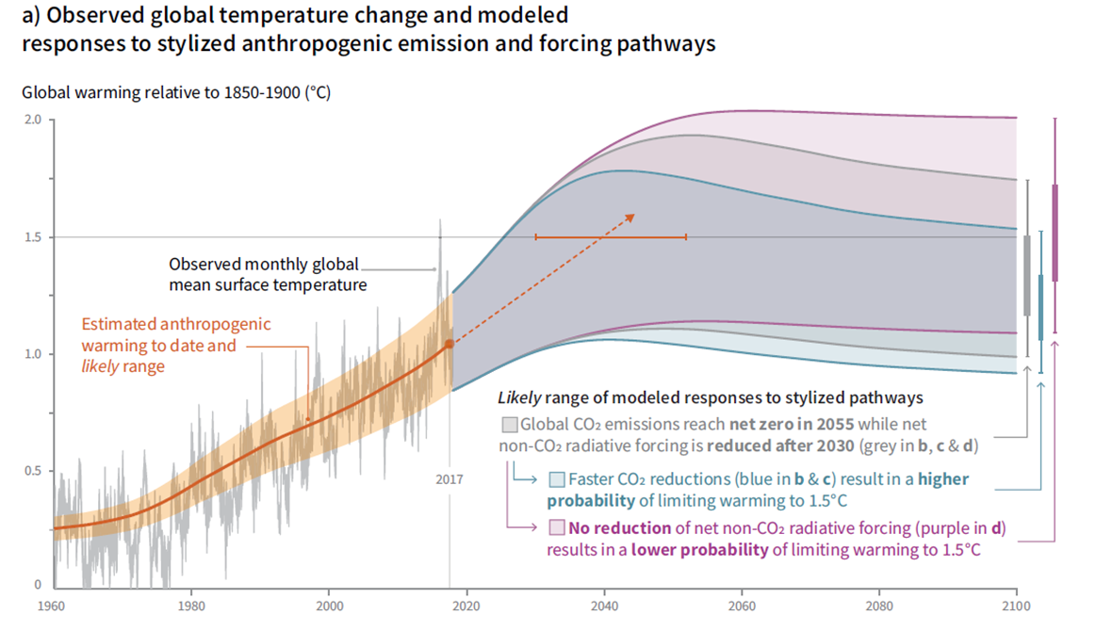

Slide 4
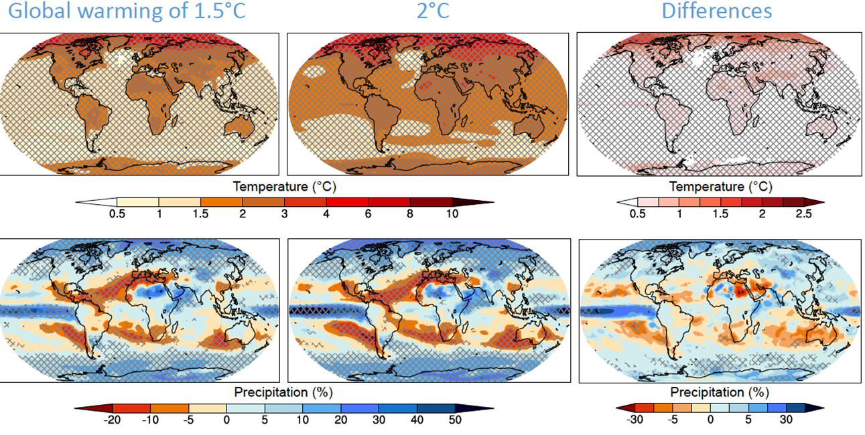

Slide 5
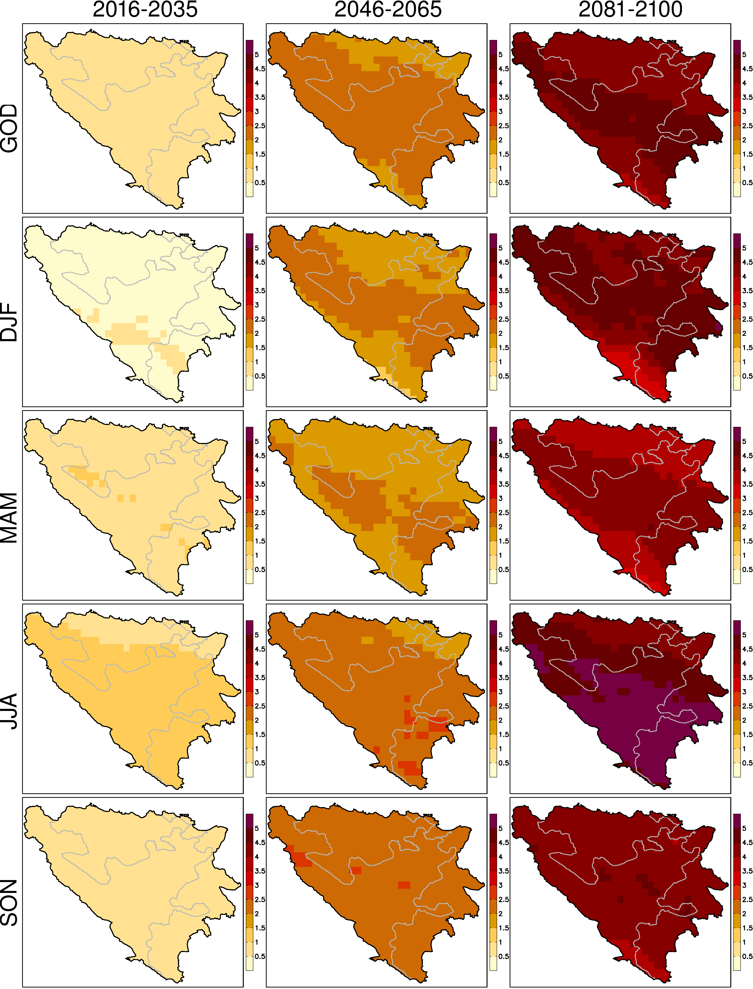
Promjena srednje dnevne temperature (u oC) u odnosu na referentni period 1986.-2005.

Slide 6
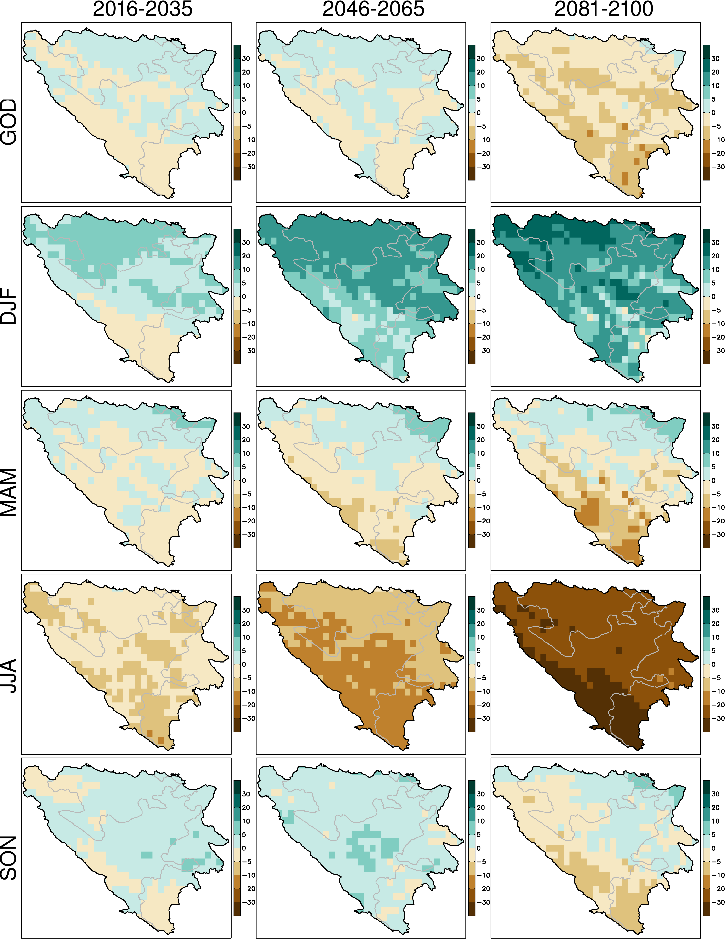
Promjena srednjih dnevnih padavina (u %) u odnosu na referentni period 1986.-2005.

Slide 7
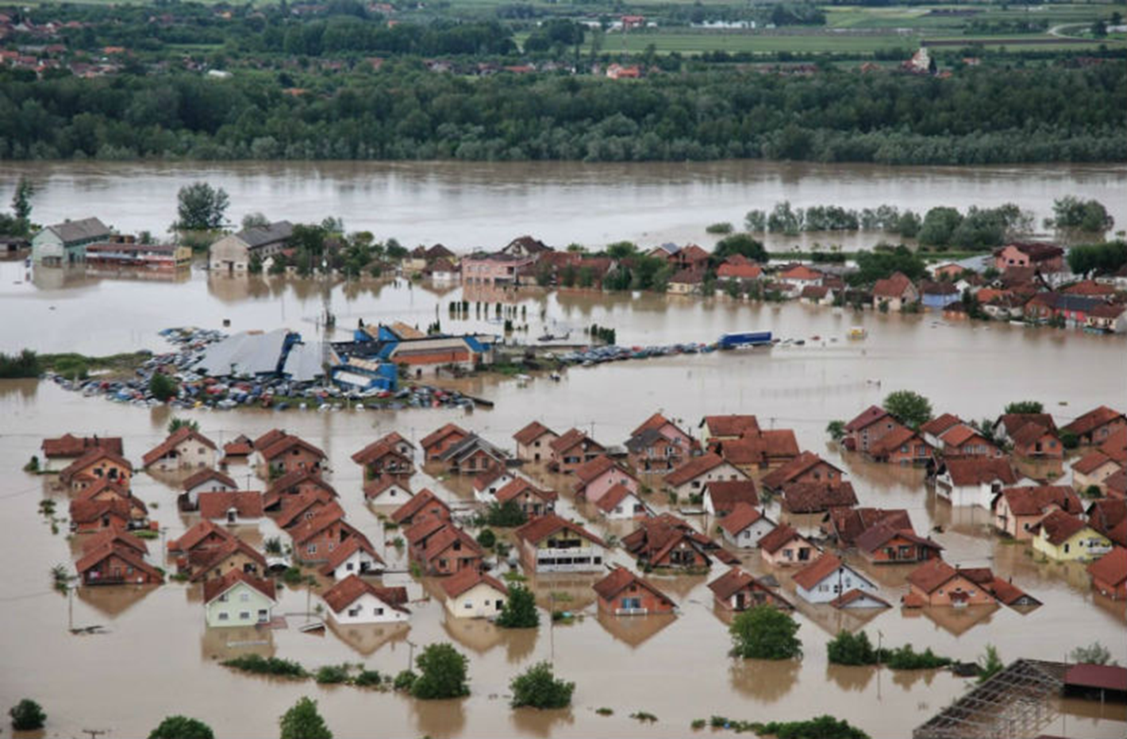
Key climate pressures
Floods, droughts, storms, ….

Slide 8
Insurance study
Study aim: Preparing business subjects to manage flood risks through the transfer and adaptation of technologies, focused on a selection of adequate methods for risks funding.
The main study question: Is it possible to manage the risks from natural disasters through insurance as a special method of risk funding, taking into consideration the needs of business subjects and the key features of the insurance products package for natural disasters?

Slide 9
Sample and methodology
The questionnaire was designed and the primary data collected through an online survey and telephone interviews.
The following natural disasters were included in the study: flood, landslide and earthquake.
The following insured objects were addressed: the construction part of a building and the equipment and stock in the building.
The sample included 490 business entities.

Slide 10
Feature | Mean | Median | Standard deviation | Min. | Max.
Age of owner/ manager/decision maker | 48.65 | 50 | 9,622 | 25 | 73
Income generated in the last business year (BAM) | 10,221,351 | 750,000 | 45,581,927 | 100 | 523,880,345
Table 1. Characteristics of the business subjects

Slide 11
Identifying the needs of the business subjects
Type of natural disaster | Experience of damage caused by natural disasters
 | YES |  | NO |  | Total
 | Freq. | % | Freq. | % | Freq. | %
Water stream flood | 149 | 30.4 | 341 | 69.6 | 490 | 100
Landslide | 25 | 5.2 | 458 | 94.8 | 483 | 100
Earthquake | 6 | 1.3 | 471 | 98.7 | 477 | 100
Table 2. Experience of damage caused by natural disasters
Type of natural disaster | Being located in the natural disasters danger zone
 | YES |  | NO |  | I DO NOT KNOW |  | Total
 | Freq. | % | Freq. | % | Freq. | % | Freq. | %
Water stream flood | 112 | 31.9 | 221 | 63.0 | 18 | 5.1 | 351 | 100
Landslide | 33 | 9.4 | 295 | 83.8 | 24 | 6.8 | 352 | 100
Earthquake | 65 | 18.5 | 150 | 42.6 | 137 | 38.9 | 352 | 100
Table 3. Exposure to the risks of natural disasters

Slide 12
Type of natural disaster | Extreme occurrence of damage |  | Other | Total
 | Year | Freq.
Water stream flood | 2014 | 119 | In the period 1999-2013, 24 instances of damage were recorded. In the period 2015-2018, 29 instances of damage were recorded. | 172
Landslide | 2014 | 16 | In the period 1960-2013, 13 instances of damage were recorded. In the period 2015-2018, 9 instances of damage were recorded. | 38
Earthquake | - | - | In the period 1969-2018, 6 instances of damage were recorded. | 6
Table 4. Time aspect of damage caused by natural disasters

Slide 13
Experience of flood damage | Danger zone: flood |  |  | χ² (p-value)
 | YES | NO | I DO NOT KNOW
YES | 70 | 25 | 7
NO | 42 | 196 | 11 | .000
Table 5. Results of the Chi-squared test (experience of flood damage vs. flood danger zone)
Natural disaster | Willingness to pay insurance against natural disasters for business buildings
 | YES |  | NO |  | I DO NOT KNOW |  | Total
 | Freq. | % | Freq. | % | Freq. | % | Freq. | %
Water stream flood | 143 | 39.8 | 160 | 44.6 | 56 | 15.6 | 359 | 100
Landslide | 92 | 25.6 | 200 | 55.7 | 67 | 18.7 | 359 | 100
Earthquake | 111 | 30.9 | 191 | 53.2 | 57 | 15.9 | 359 | 100
Table 6. Willingness to pay insurance

Slide 14
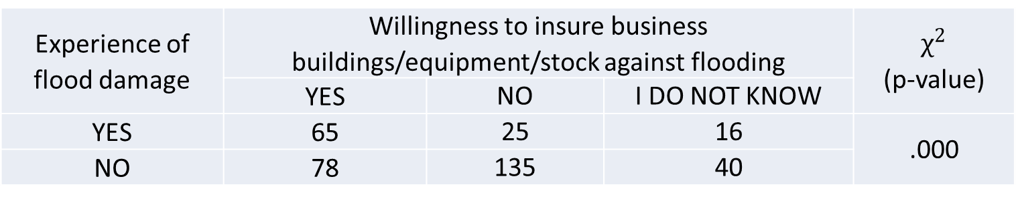
Experience of flood damage | Willingness to insure business buildings/equipment/stock against flooding |  |  | $$χ^{2}$$ (p-value)
 | YES | NO | I DO NOT KNOW
YES | 65 | 25 | 16 | .000
NO | 78 | 135 | 40
Table 7. Results of the Chi-squared test (experience of flood damage vs. willingness to insure against flooding)
Possession of an insurance policy for a business building or equipment/stock | Freq. | % | Of that number, flood risk included
 |  |  | YES |  | NO |  | I DO NOT KNOW
 |  |  | Freq. | % | Freq. | % | Freq. | %
YES | 168 | 46.9 | 75 | 45.5 | 68 | 41.2 | 22 | 13.3
NO | 190 | 53.1 | - | - | - | - | - | -
TOTAL | 358 | 100.0 | - | - | - | - | - | -
Table 8. Inclination toward insurance (part I)

Slide 15
The attitude that an insurance policy should include flood risk regardless higher amount of premium | Freq. | %
YES | 139 | 39.3
NO | 116 | 32.8
I DO NOT KNOW | 99 | 28.0
TOTAL | 354 | 100
Table 9. Inclination toward insurance (part II)
Inclination toward risk retention | Attitude that insurance is useless and a waste of money
 | Freq. | %
YES | 54 | 15.3
NO | 201 | 56.8
I DO NOT KNOW | 99 | 28.0
Total | 354 | 100
Table 10. Inclination toward risk retention

Slide 16
Confidence in the insurance system | Freq. | %
YES | 104 | 25.7
NO | 148 | 36.6
I DO NOT KNOW | 152 | 37.6
Total | 404 | 100
Table 11. Perception of insurance system reliability
All three assessed disasters showed a significant connection between the respondents’ willingness to pay insurance and the following variables:
inclination to purchase commercial insurance products,
inclination toward risk retention, and
their perception of insurance system reliability.

Slide 17
Identifying the needs of large enterprises
Three of seven business subjects demonstrated a positive attitude toward the obligation to insure against flood and landslide and two toward insurance against earthquake.
Not a single business was inclined toward risk retention, but only three businesses expressed confidence in the insurance system.
Three business subjects expressed their willingness to pay for insurance against flood and landslide and only one was ready to pay insurance against earthquake.

Slide 18
Funding source | Parameters of the descriptive statistical analysis
 | N | Min. (%) | Max. (%) | Average (%) | Standard deviation
Own | 334 | 0 | 100 | 35.03 | 30.425
Loan | 320 | 0 | 100 | 42.48 | 30.983
Table 16. Descriptive statistical analysis of the possibilities for partial funding of damage
Expected financial support from donors | Freq. | %
YES | 103 | 25.5
NO | 162 | 40.1
I DO NOT KNOW | 139 | 34.4
Total | 404 | 100
Table 17. Perception of financial support from donors in the case of damage caused by natural disasters

Slide 19
Concept of the insurance product against natural disasters
The following aspects are included:
  obligation of insurance,
  the amount of the insurance premium for the construction part of a business building,
  equipment and stock, and
  the expected amount based on the insured sum (amount of expected compensation for the damage caused to the business building, equipment and stock)

Slide 20
Natural disaster | Attitude toward the mandatory insurance for business buildings by lower price compared to commercial one
 | YES |  | NO |  | I DO NOT KNOW |  | Total
 | Freq. | % | Freq. | % | Freq. | % | Freq. | %
Water stream flood | 125 | 34.8 | 153 | 42.6 | 81 | 22.6 | 359 | 100
Landslide | 116 | 32.3 | 161 | 44.8 | 82 | 22.8 | 359 | 100
Earthquake | 122 | 34.0 | 155 | 43.2 | 82 | 22.8 | 359 | 100
Table 18. Attitude toward mandatory insurance for business buildings

Slide 21
There was a connection between the mandatory insurance and the following:
  willingness to insure a business building and equipment/stock in the building against all three assessed natural disasters;
  experience of flood damage;
  exposure to landslide and earthquake risks;
  inclination toward risk retention for all three natural disasters;
  inclination toward insurance of a business building and equipment/stock against all three natural disasters;
  mandatory inclusion of flood risk in an insurance policy for a business building and equipment/stock with a corresponding increase in the price of the insurance policy.

Slide 22
Description | Amount (in BAM)
Annual insurance premium for the construction part of a building | <=200 | 201-500 | 501-2,000 | 2,001+
Anticipated compensation for the insured construction part of a building | 53,718 | 130,156 | 244,893 | 15,464,242
Table 29. Anticipated premium and insured sum for damage caused to a business building by the natural disasters
Description | Amount (in BAM)
Annual insurance premium for equipment in a building | <= 200 | 201-500 | 501-2,000 | 2,001+
Anticipated compensation for insured equipment in a building | 29,321 | 130,566 | 187,280 | 9,404,355
Table 30. Anticipated premium and insured sum for the damage caused to equipment in a building by natural disasters

Slide 23
Description | Amount (in BAM)
Annual insurance premium for stock in a building | <= 150 | 151-500 | 501-1,200 | 1,201+
Anticipated compensation for insured stock in a building | 19,369 | 357,537 | 236,050 | 996,400
Table 31. Anticipated premium and insured sum for damage caused to stock in a business building by natural disasters

Slide 24
Conclusions
The business subjects have a relatively high need for insurance against natural disasters.
There is significant potential for development of an insurance package against natural disasters.
The respondents had a positive attitude toward the obligation to insure against the assessed disasters according to a lower price compared to the commercial one.
The fixed and variable expected premium and anticipated insured amount were determined.

Slide 25
Recommendations
The need for the organisation of an awareness campaign.
The campaign should also be organised for large enterprises and should focus on the need for an early warning system.
Design and introduce the insurance products package against natural disasters for business subjects and include unified risks from flood, landslide and earthquake.

Slide 26
Thank you for attention
Jovanka Ćetković jovanka.cetkovic@undp.org www.ba.undp.org

