Slide 1
Data Science in Insurance
9
Arandjelovac, 19.06.2021.
Nenad Milikic, National Mortgage Insurance Corporation
Chief actuary

Slide 2
Why Data Science?
To learn a bunch of data analysis tools?
To better understand some aspect of the world.
We want to use data to do so.

Slide 3
Why Data Science?
There is one primary goal for data scientist...
… but a big goal…
This is to be able to find an open dataset and explore it using the tools and, either before the exploration or during, to develop a meaningful research question which could be answered by the dataset.

Slide 4
Why Data Science?
Data science is having a huge impact on businesses, academia, and government.
However, it is sometimes easy to overlook how big data is hiding in plain sight.
Massive data sets hold answers to some of the largest questions of our time.

Slide 5
The Rise of Data Science
It might seem that data science came out of nowhere.
However, data science has been around for a very long time.
Scientists have always used data to gain insight based on observations.

Slide 6
The Rise of Data Science
Data science is suddenly on the rise because our ability to collect data in real time has significantly increased with data coming from a variety of places and increased ability for large scale data processing.
So, this data growth combined with the advances in storage, networking, and computing at scale has brought us to a new era of data science.
It is nearly impossible to find an industry, scientific discipline, or engineering endeavor today that is not impacted by data science.

Slide 7
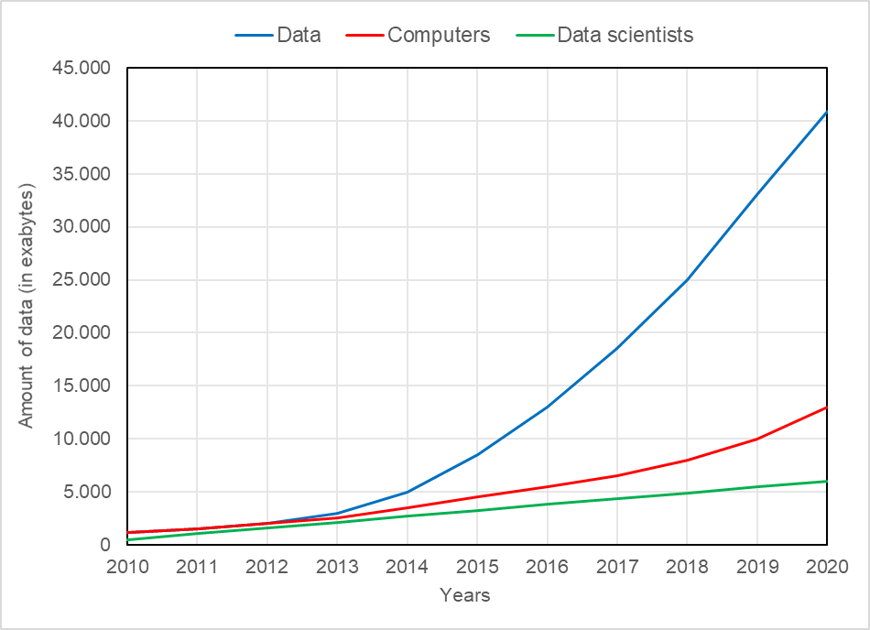
The Rise of Data Science
Data, computers and data scientists available in the world

Slide 8
The Data Science Process
There are 5 key steps in the overall process of data science:
1. Data acquisition
2. Data preparation
3. Data analysis
4. Presentation and reporting of insights
5. Turning the insights into data-driven actions

Slide 9
The Data Science Skills
How to ask the right questions and how to answer those questions requires a deep understanding of programming, statistics and machine learning.
All of these require deeper knowledge and skills in domain expertise.
That’s a lot of skills to have for a single person, so in reality, data science implies a team of people.

Slide 10
The Data Science Skills
Python is a clear leader in many data science categories, although learning any of the programming languages (R, Java, C, Scala, Julia) is a good idea.
In addition to being an easy-to-learn and readable language, Python is an open language with a vibrant community.
It offers an ever-growing set of data management, analytical processing, and visualization libraries that make Python applicable to every step of the data science process.

Slide 11
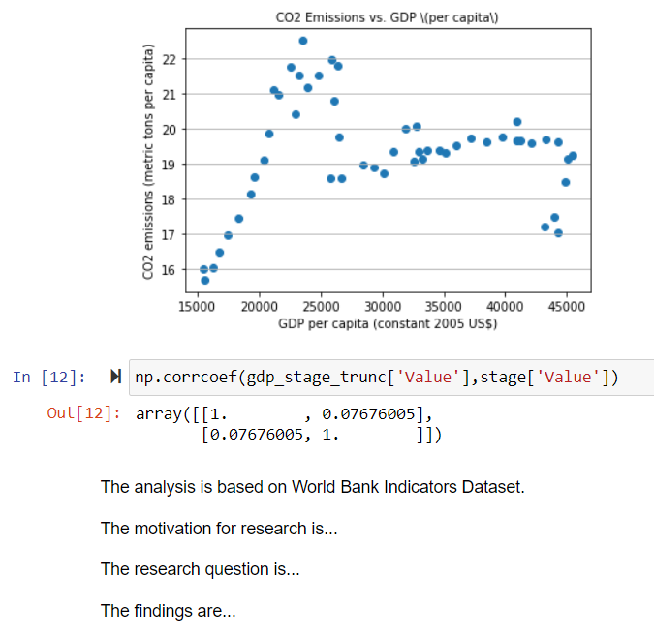
The Data Science Skills
Jupyter Notebook
makes Python
based analysis
more producible
and repeatable
and helps with
team communication.

Slide 12
Data Science in Insurance
Relation of insurance industry to risk, as one of the most competitive and less predictable business areas, caused its strong dependency on statistics.
Insurance companies today have a wide range of information sources for the relevant risk assessment.
Big data technologies are applied to predict risks and claims, to monitor and to analyse them and to develop effective strategies for customers attraction and retention.

Slide 13
Data Science in Insurance
Data science could introduce substantial innovation in the insurance industry:
How products are offered and to whom.
Can help to better understand the nature of the risks taken.
Can help to identify relationships which would otherwise have remained hidden.
Can help to make better predictions.

Slide 14
Data Science in Insurance
Data science has already been applied in various activities in the insurance industry:
Fraud detection
Risk assessment
Price optimization
Claims prediction
Personalized marketing
Claims management
Customer segmentation
Healthcare insurance

Slide 15
Case Study: Geodemographic Segmentation Model
An insurance company noticed unusual churn rate of its insureds and it wants to understand what is the reason for such behaviour.
The data scientist took a sample of 10.000 randomly selected insureds from the portfolio of insurance company and his task is to create a geodemographic model and to advise the company which clients are under the higher risk to leave.

Slide 16
Case Study: Geodemographic Segmentation Model
There is a binary outcome, for example - to approve or not a loan in a bank, or to predict whether a product will break down.
Whenever a question related to our business problem has an answer yes or no, logistic regression is used.
Logistic regression is the most widely used regression in data science.

Slide 17
Case Study: Geodemographic Segmentation Model
Of any independent variables that are available to us, logistic regression will indicate which of them affects the outcome that we observe (dependent variable).
There could be many independent variables that are analysed in the process of finding answers to some business problem.
In order to be able to successfully analyse this problem, data scientist has to be able to use some software package for statistical analysis, e.g. Gretl, SPSS, EViews, SAS (or Jupyter Notebook and Python).

Slide 18
Case Study: Geodemographic Segmentation Model
The process commonly starts with identification of categorical variables and creation of dummy variables.
The process then continues to the step that implies the model creation where the backward elimination procedure is used.
The result of the process are valuable insights about relations between variables that are further used to classify clients into segments for making final decisions.

Slide 19
The Data Science Quote
“Without data, you’re just another person with an opinion.“
Dr. William Edwards Deming,
was an American engineer, statistician, professor, author, lecturer, and management consultant. Educated initially as an electrical engineer and later specializing in mathematical physics, he helped develop the sampling techniques still used by the U.S. Department of the Census and the Bureau of Labor Statistics.

