Slide 1
THE PROLONGED IMPACT OF NEGATIVE ECB POLICY RATES ON RISK TAKING OF INSURANCE COMPANIES
Đorđe Đukić, University of Belgrade, Faculty of Economics
Mališa Đukić, Union University Belgrade, Belgrade Banking Academy

Slide 2
Content of the presentation
The prolonged asymmetry between ECB policy rates and Fed policy rates during 2021-2022
The impact of ECB monetary policy of negative interest rates on bond yields in 2021
The impact of ECB monetary policy of negative interest rates on risk taking of insurance companies

Slide 3
The prolonged asymmetry between ECB policy rates and Fed policy rates
ECB continues its experiment of implementing monetary policy with 0% interest rates on main refinancing operations and negative interest rate on deposit facilities. FED has no intention of taking part in such an experiment.
As presented in Figures 1 and 2 for the third decade of March 2021 current target rate (0-0,25%) probabilities for April 28th 2021 FED meeting was 97,8% and for December 18th 2021 FED meeting was 91,4%.
One month later, April 18th 2021, number of investors expecting the increase in key interest rates from 0,25% to 0,50% in December 2021 slightly increased. As presented in Figure 3, the probability of such an event increased from 6,40% to 13,65% as of March 18th, 2021

Slide 4
Current Target Rate Probabilities for 15 December 2021 FED Meeting

Slide 5
The prolonged asymmetry between ECB policy rates and Fed policy rates
FED key interest rate in medium term should be analyzed in the context of enormous growth of US federal debt that reached 100,1% of GDP in 2020. This was higher than the forecasted 98,2%.
According to the forecasts of US Congressional Budget Office from 2020 the federal debt to GDP would reach 195% in 2050.
What are the possible consequences of the sudden increase of public debts as well as the private debts not only in US but in other developed countries globally?

Slide 6
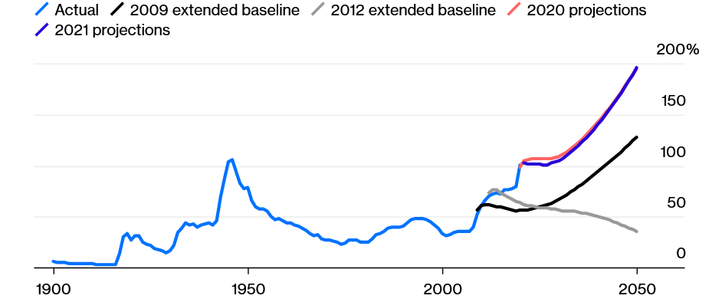
Federal debt in public hands as a share of GDP

Slide 7
The prolonged asymmetry between ECB policy rates and Fed policy rates
First, there is a strong probability that the private sector would tend to increase its savings and would maintain high savings rates that were recorded in the decade after the outbreak of the global financial crisis in 2008.
Secondly, ultra-expansionary monetary policy and low interest rates are likely to remain in the years to come which would allow governments and private sector to maintain high levels of debt.
Thirdly, as a result of higher credit activity higher liquidity coupled with monetary incentives in the form of quantitative easing would result in more asset reflation.

Slide 8
The impact of ECB monetary policy of negative interest rates on bond yields in 2021
Government bond yields were at record low levels beginning of 2021:
10-Year Eurozone Central Government Bond Par Yield Curve is at 0,12% (March 18, 2021) compared to 0,70% last year. This is lower than the long-term average of 2,53%.
20-Year Eurozone Central Government Bond Par Yield Curve is at 0,73% (March 18, 2021) compared to 1,09% last year. This is lower than the long-term average of 3,06%.
30-Year Eurozone Central Government Bond Par Yield Curve is at 0,98%, compared to 1,27% last year. This is lower than the long-term average of 3,22%.
The growing optimism on bond markets from March 2021 was based on the growing yields on US government bonds. The change in yields is a consequence of adopting the fiscal package on mitigating the negative impact of COVID-19 pandemic by the Congress in the amount of USD 1,9 trillion.

Slide 9
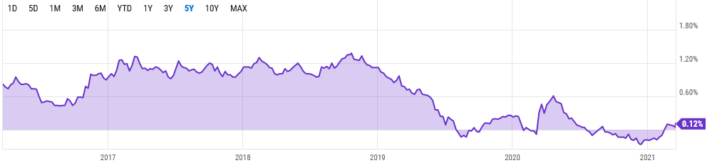
10-Year Eurozone Central Government Bond Par Yield Curve (March 29, 2016- March 18, 2021)

Slide 10
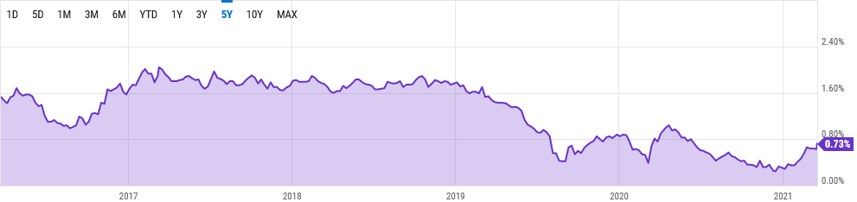
20-Year Eurozone Central Government Bond Par Yield Curve (March 29, 2016- March 18, 2021)

Slide 11
The impact of ECB monetary policy of negative interest rates on risk taking of insurance companies
One of the six priorities of insurance companies in 2021 was to
  “…refine alternative capital structure and identify plans for targeted growth investments.” - Ernst & Young (2021). 2021 Global Insurance Outlook, p. 29.
The liquidity of insurance companies in Europe was stable before the outbreak of COVID-19 pandemic. The growing needs for cash in 2020 were the consequence of increasing volatilities in bond markets.
Insurance companies in Europe will be under growing pressure to take more credit risk, liquidity risk and market risk in 2021 and first half of 2022. This is due to the continuation of ultra-expansionary monetary policy of ECB.

Slide 12
The impact of ECB monetary policy of negative interest rates on risk taking of insurance companies
Under the assumption that euro area insurance companies’ portfolio shares by rating were kept constant, average coupon income would fall from 2,8% in 2019 to 2,1% in 2025.
If insurance companies wanted to keep the portfolio income at its 2019 level it would require an increase in the share of high-yield assets from 2% of their debt securities portfolio to 30% by 2025. If more moderate scenario is analyzed, where the decline of portfolio income is only halved, the high-yield share would need to increase to 16% in 2025. - (Source: European Central Bank (2020). Financial Stability Review, November, p. 99).

Slide 13
The impact of ECB monetary policy of negative interest rates on risk taking of insurance companies
Last but not the least, the insurance companies will face to constraints in the 2021-2022 period:
First, solvency capital requirements would increase significantly if insurance companies would purchase riskier asset classes.
Secondly, there will be a limited supply of high-yield alternative asset classes on the capital market in eurozone.

Slide 14
Thank you for your attention!

