Slide 1

Estimation accuracy improvement under IAS-19
International Actuarial Advisory Company
Valeriy Baskakov, Ph.D. (Dr. Sci. (Math.)), Professor
Anna Selivanova, Ph.D. (Economics)
Ivan Gornyakov

Slide 2
Problem statement
The current practice of actuarial evaluation according to IAS-19: single decrement tables are used to describe the probability of dismissal of an employee disposal.
The basic criterion in the single decrement tables is the employee's age or years of service.
The choice of criterion is usually based on the actuary subjective experience or his assumption concerning the dependence of the employee dismissal probability from the specified parameters.
This approach objectively introduces certain inaccuracy in calculations due to not taking into account the second parameter, which is respectively the employee length of service or age, affecting the probability of his dismissal.
The aim of the presentation is to quantify this inaccuracy on the example of real data from the HR department at a large Russian enterprise of fuel and energy complex collected in 2016.

Slide 3
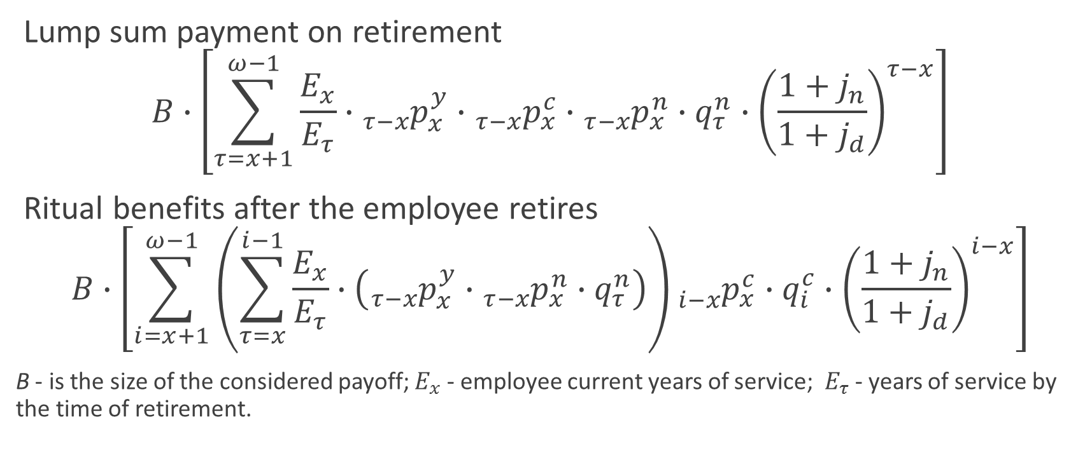
Obligations
Lump sum payment on retirement
$$B∙\left[\sum_{τ=x+1}^{ω−1}{\frac{E_{x}}{E_{τ}}∙{{}_{τ−x}^{}p}_{x}^{y}}∙{{}_{τ−x}^{}p}_{x}^{c}∙{{}_{τ−x}^{}p}_{x}^{n}∙q_{τ}^{n}∙{\left(\frac{1+j_{n}}{1+j_{d}}\right)}^{τ−x}\right]$$
Ritual benefits after the employee retires
$$B∙\left[\sum_{i=x+1}^{ω−1}{\left(\sum_{τ=x}^{i−1}{\frac{E_{x}}{E_{τ}}∙\left({{}_{τ−x}^{}p}_{x}^{y}∙{{}_{τ−x}^{}p}_{x}^{n}∙q_{τ}^{n}\right)}\right)}{{}_{i−x}^{}p}_{x}^{c}∙q_{i}^{c}∙{\left(\frac{1+j_{n}}{1+j_{d}}\right)}^{i−x}\right]$$
B - is the size of the considered payoff; $E_{x}$ - employee current years of service; ${ E}_{τ}$ - years of service by the time of retirement.

Slide 4
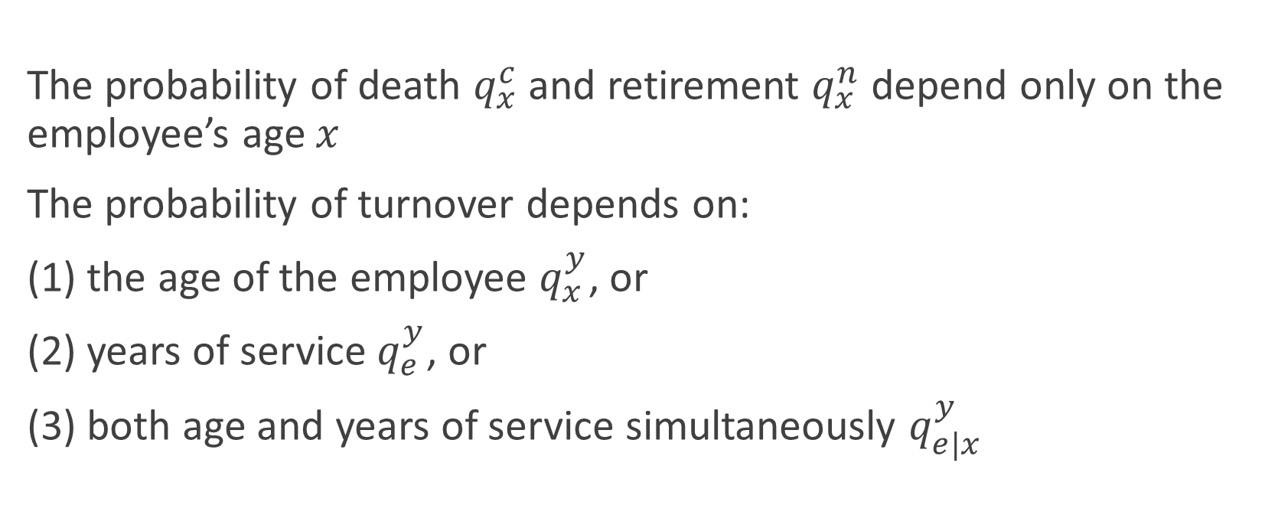
Assumption
The probability of death $q_{x}^{c}$ and retirement $q_{x}^{n}$ depend only on the employee’s age $x$
The probability of turnover depends on:
(1) the age of the employee $q_{x}^{y}$, or
(2) years of service $q_{e}^{y}$, or
(3) both age and years of service simultaneously $q_{e|x}^{y}$

Slide 5
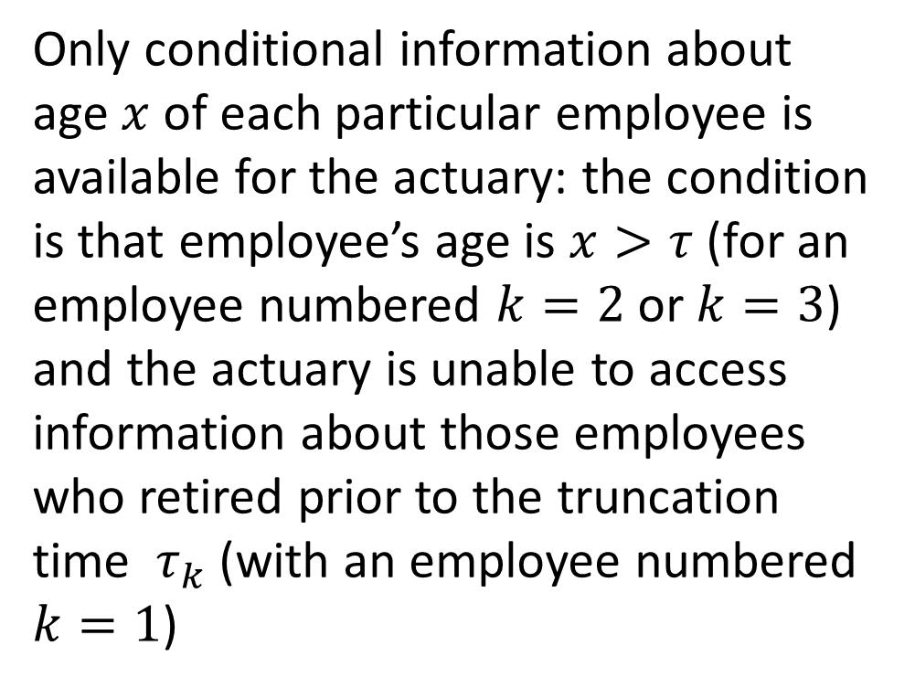
Statistic data structure
Only conditional information about age $x$ of each particular employee is available for the actuary: the condition is that employee’s age is $x>τ$ (for an employee numbered $k=2$ or $k=3$) and the actuary is unable to access information about those employees who retired prior to the truncation time $τ_{k}$ (with an employee numbered $k=1$)
The scheme of formation of left truncated and right censored data

Slide 6
Sample characteristics
Indicator |  | Measure unit | Male | Female
Sample volume |  | people | 10827 | 7290
Truncation level | dismissal | % | 89.5 | 89.2
 | retirement | % | 100.0 | 100.0
Censoring level | dismissal | % | 93.6 | 95.1
 | retirement | % | 98.4 | 97.8
Minimal age |  | year | 15.41 | 14.49
Maximum age |  | year | 75.48 | 75.48
Minimal work experience |  | year | 0 | 0
Maximum work experience |  | year | 46.66 | 47.00

Slide 7
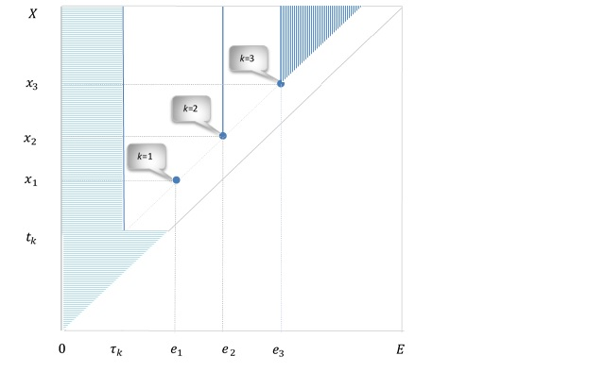
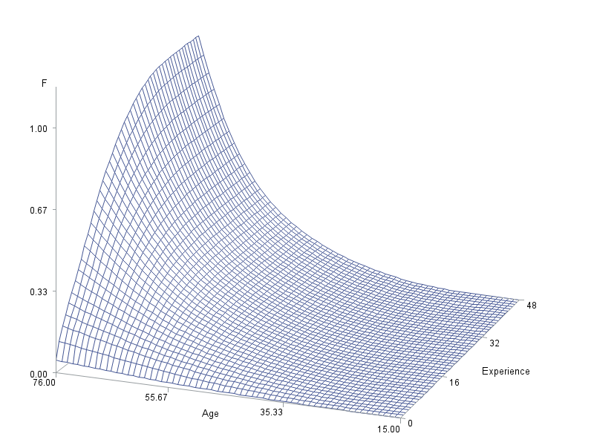


Turnover distribution function
Statistic data structure of two-dimensional $\left(X, E\right)$ vector
Nonparametric estimation of joint distribution function $F(x,e)$

Slide 8
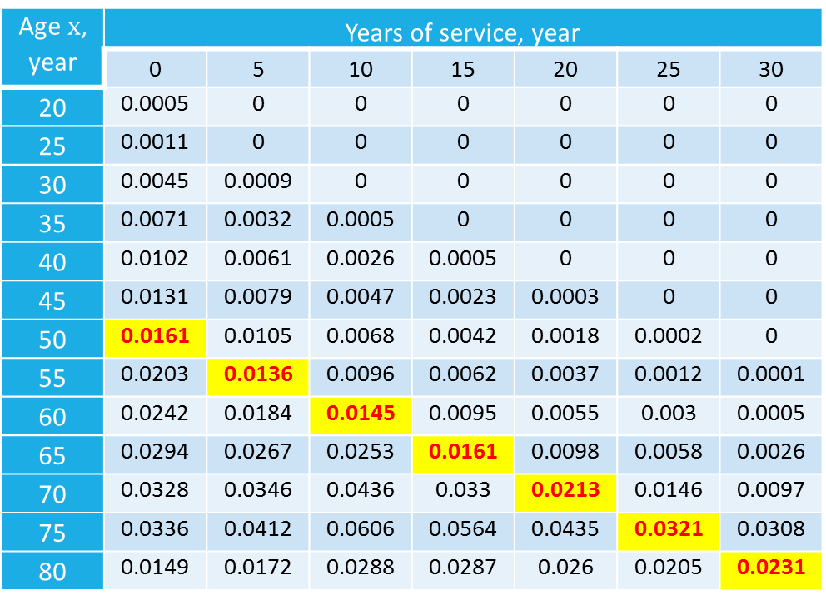

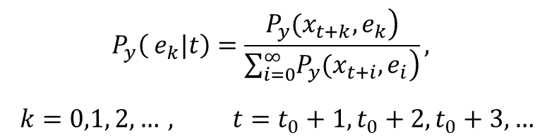
The turnover probability distribution
Age $x$, year | Years of service, year
 | 0 | 5 | 10 | 15 | 20 | 25 | 30
20 | 0.0005 | 0 | 0 | 0 | 0 | 0 | 0
25 | 0.0011 | 0 | 0 | 0 | 0 | 0 | 0
30 | 0.0045 | 0.0009 | 0 | 0 | 0 | 0 | 0
35 | 0.0071 | 0.0032 | 0.0005 | 0 | 0 | 0 | 0
40 | 0.0102 | 0.0061 | 0.0026 | 0.0005 | 0 | 0 | 0
45 | 0.0131 | 0.0079 | 0.0047 | 0.0023 | 0.0003 | 0 | 0
50 | 0.0161 | 0.0105 | 0.0068 | 0.0042 | 0.0018 | 0.0002 | 0
55 | 0.0203 | 0.0136 | 0.0096 | 0.0062 | 0.0037 | 0.0012 | 0.0001
60 | 0.0242 | 0.0184 | 0.0145 | 0.0095 | 0.0055 | 0.003 | 0.0005
65 | 0.0294 | 0.0267 | 0.0253 | 0.0161 | 0.0098 | 0.0058 | 0.0026
70 | 0.0328 | 0.0346 | 0.0436 | 0.033 | 0.0213 | 0.0146 | 0.0097
75 | 0.0336 | 0.0412 | 0.0606 | 0.0564 | 0.0435 | 0.0321 | 0.0308
80 | 0.0149 | 0.0172 | 0.0288 | 0.0287 | 0.026 | 0.0205 | 0.0231
$$P_{y}\left( e_{k}|t\right)=\frac{\left.P_{y}(x_{t+k},e_{k}\right)}{\sum_{i=0}^{∞}{\left.P_{y}(x_{t+i},e_{i}\right)}},$$
$$k=0,1, 2, …, t=t_{0}+1,t_{0}+2, t_{0}+3, …$$
$$P_{y}\left( e|t=50\right)$$

Slide 9
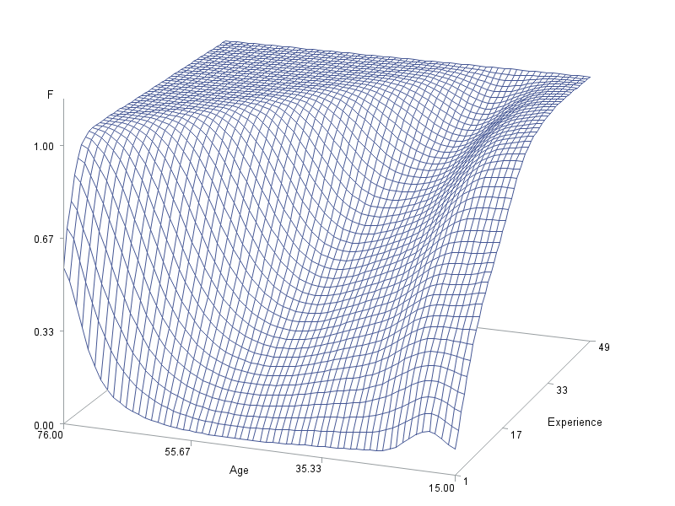
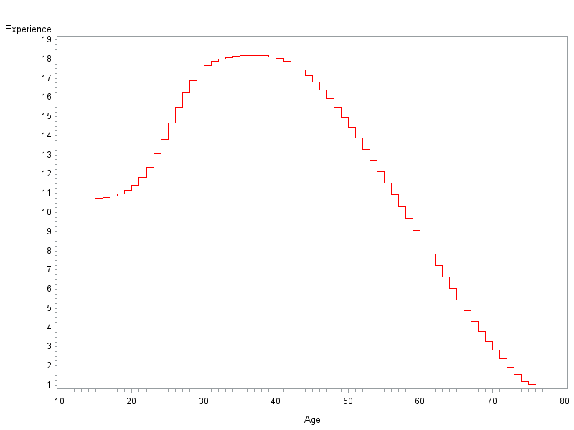

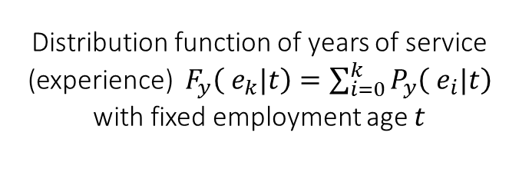
Conditional distribution function and mean
Distribution function of years of service (experience) $F_{y}\left( e_{k}|t\right)=\sum_{i=0}^{k}{P_{y}\left( e_{i}|t\right)}$ with fixed employment age $t$
The mean of employee’s years of service (experience) with fixed employment age $t$

Slide 10
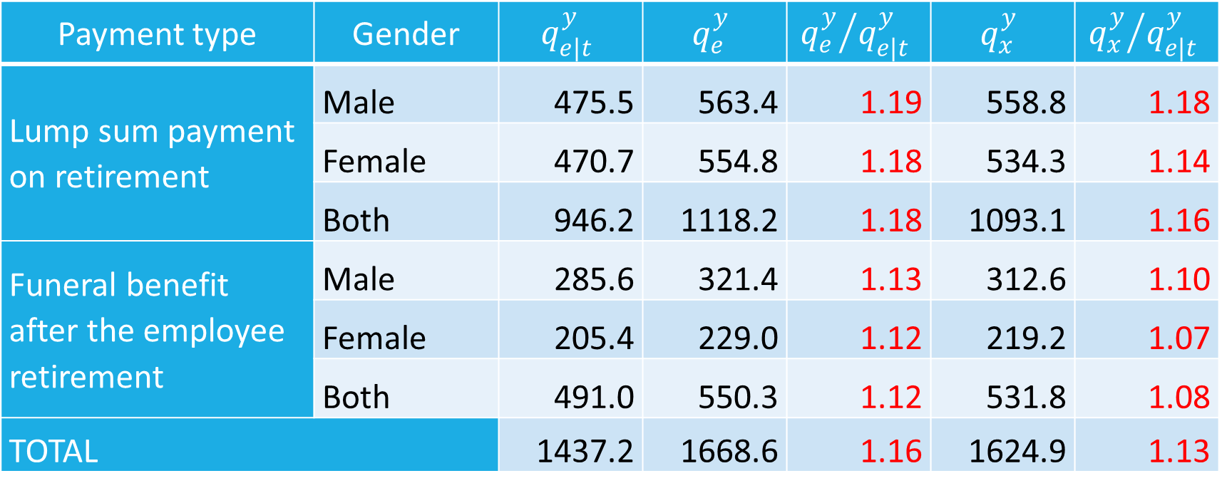
Obligations calculation: results
Payment type | Gender | $$q_{e|t}^{y}$$ | $$q_{e}^{y}$$ | $${q_{e}^{y}}/{q_{e|t}^{y}}$$ | $$q_{x}^{y}$$ | $${q_{x}^{y}}/{q_{e|t}^{y}}$$
Lump sum payment on retirement | Male | 475.5 | 563.4 | 1.19 | 558.8 | 1.18
 | Female | 470.7 | 554.8 | 1.18 | 534.3 | 1.14
 | Both | 946.2 | 1118.2 | 1.18 | 1093.1 | 1.16
Funeral benefit after the employee retirement | Male | 285.6 | 321.4 | 1.13 | 312.6 | 1.10
 | Female | 205.4 | 229.0 | 1.12 | 219.2 | 1.07
 | Both | 491.0 | 550.3 | 1.12 | 531.8 | 1.08
TOTAL |  | 1437.2 | 1668.6 | 1.16 | 1624.9 | 1.13

Slide 11
Turnover probability
Dependence of turnover probability on the estimation method, employment age and length of service

Slide 12
Thank you for your attention!
International Actuarial Advisory Company Llc
3A, 1-st Khoroshevskiy pr., 125284, Russia
Web.: www.IAAC.ru
E-mail chief@actuaries.ru
tel.: +7 903 100 2660

