Slide 1
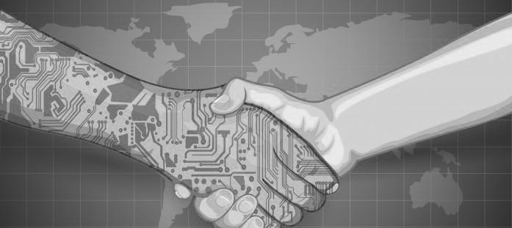
Presenter:
Serbia
Boško Petrović
Generalni direktor
GENERALI REOSIGURANjE SRBIJA a.d.o.
Challenges in the development of the reinsurance market
CHALLENGES AND PROSPECTS FOR DEVELOPMENT OF INSURANCE MARKET -
15 YEARS LATER
XV INTERNATIONAL SYMPOSIUM
Zlatibor, 18-21. maj 2017.

Slide 2
Presenter:
Serbia
Boško Petrović
Generalni direktor
GENERALI REOSIGURANjE SRBIJA a.d.o.
Digitalization
XV INTERNATIONAL SYMPOSIUM
Zlatibor, 18-21. maj 2017.

Slide 3

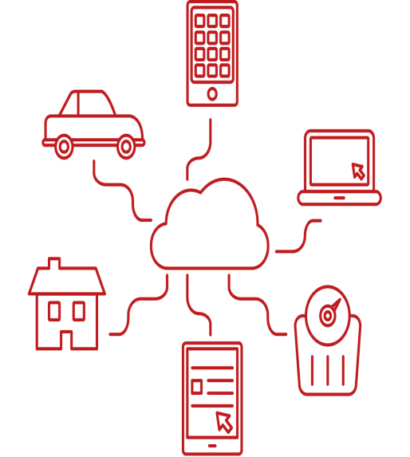

…Seismic shift happening in the industry
Introduction
Active presence
in Customers’ life through
Shift from Coverage to
New customer
journey
From policy to solution
From data to information
Prevention
&
Protection
Mobile

Slide 4

Digital journey…
Journey to a connected customer
Motor
Home
Health

Slide 5





Telematics allows to generate additional value for all stakeholders: customers, distribution network, insurers and society
Customers
Distribution network
Insurer
Society

Slide 6



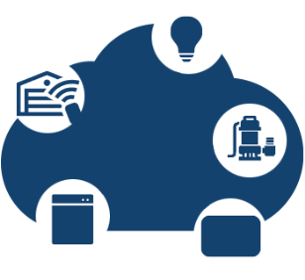


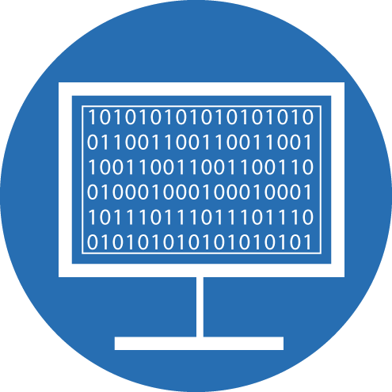
Digitalization
Data Science &
Software Engineering
Telematics
Behavioural
Profiling
Internet of Things
DOMAIN
EXPERTISE
What is Data Science?
Data Science is the art of converting raw data into actionable insight.
It helps organisations make informed decisions.
MATHEMATICS
COMPUTER SCIENCE

Slide 7
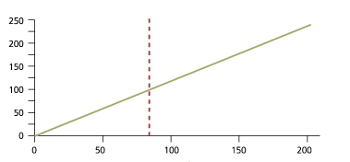
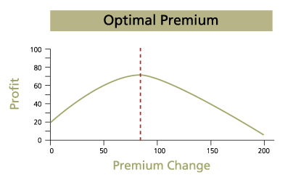
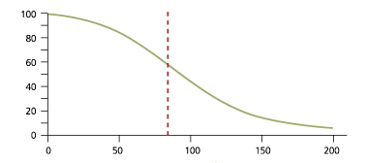
What is Data Science?
What is price optimization?
As price increases , so does margin…
Price optimisation
Margin vs Price
Profit vs Price
Margin
Profit
Price
…however the probability of retaining the client decreases
Optimal price
Retention probability vs Price
The purpose is to find the price to optimise profit or volume based on a number of business constraints
Retention probability
Price

Slide 8












Insurer is with customer in the moment of need
Example motor
A new customer buys a policy
Going to the airport,
the customer is offered a travel policy
Alerts against any peril
Driving score through mobile App
Immediate assistance in case of accident
Renewal
+ other insurance proposals
Telematics box
Driving behavior is monitored
Data stored in cloud
Smart modelling
Analytics using smart indicators
Claim assessment and fraud detection

Slide 9

“My Drive”
Purpose of MyDrive
  Make simple the complex science of driver behaviour
MyDrive
Cognitive psychology
Psychology of individual differences
Driving safety & best practice
Driving capability is a complex mix of cognitive and individual personality elements, as well as skills and competence.
MyDrive combines the expertise from three different disciplines and organisations resulting in the development of our profiling engine.
MyDrive delivers calibrated and contextualised outputs which add real value to the insurer’s proposition.

Slide 10



MyDrive Telematics Platform
MyDrive has a telematics platform that can deliver an end-to-end Usage Based Insurance programme. We support multiple App fleets in multiple territories, as well as devices managed by 3rd parties.
Off-line
Analysis
Device Management
Data Management
& Storage
Driver Scoring
Insurer’s
Portal
Multiple App Fleets in multiple territories
3rd Party Management layers
OBD & OBU Fleets managed by 3rd parties

Slide 11

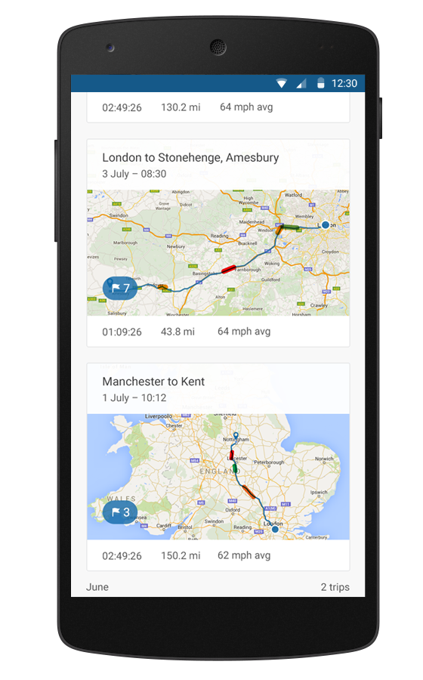



What is Data Science?
The MyDrive Application
Automatic trip recording
Driver score
Educational driving feedback
Trip summaries and progress
Accident checklist
Configurable App for Android and iOS
Analytics
Driver Education
Autostart
Support
.

Slide 12
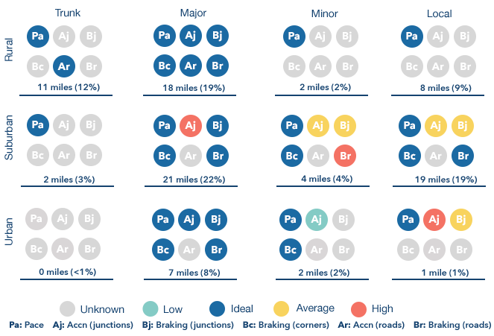
MyDrive Profiler Output

Slide 13
Digital journey…
Journey to a connected customer
Motor
Home
Health

Slide 14







Home - More and more a “Smart home”
Three things to make a house smart:
Sensors / actuators enabling home automation and services
Connectivity (e.g. wire, cable, wireless,..)
Capability to send and receive data and to make use of them
Security
Motion detection
Intrusion remote monitoring
Safety
Fire detection
Water leakage
Carbon monoxide
Health
Panic button
Fall detection
Vitals monitoring
Energy
Thermostat control
Electricity, Water,
Gas monitoring
Multimedia
Dock Station
Music storage
Audio/video streaming
Comfort
Lightings
Openings
Motorizations

Slide 15
Digital journey…
Journey to a connected customer
Motor
Home
Health

Slide 16
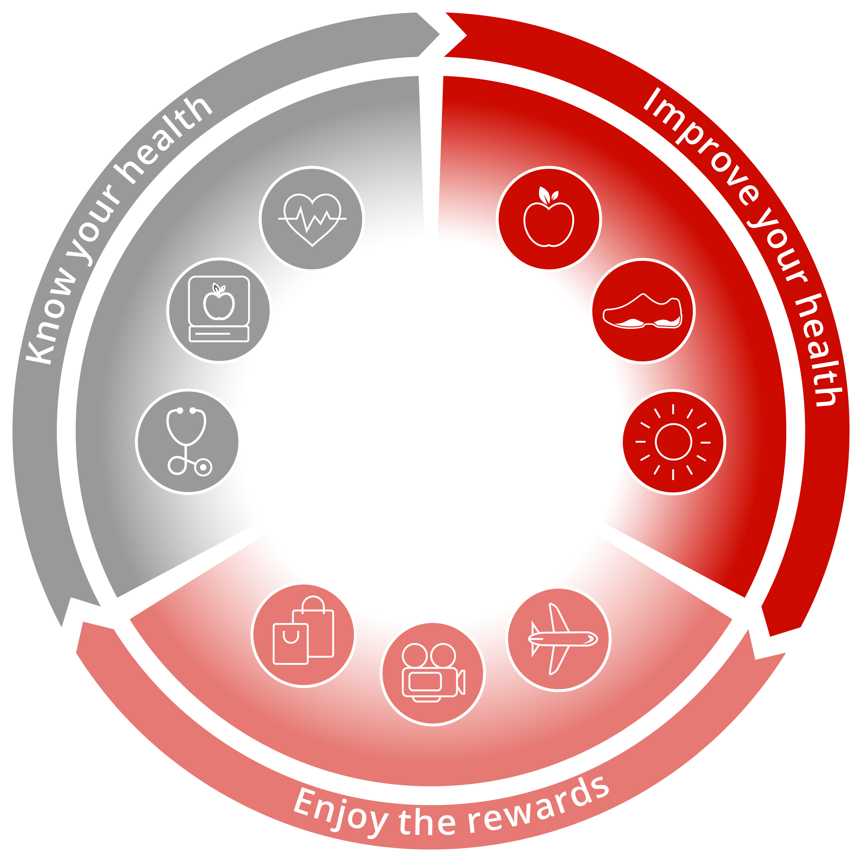
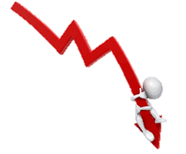



Health
The Vitality Wellness Program
1
2
Know your health
The customer determines his personal health and fitness level and determines health goal.
Users can choose out of a wide range of activities to do something for their health.
Improve your health
The customer works towards his personal target.
An attractive network of partners support them.
Customers earn points and reach a Vitality status by engaging in activities and reaching their targets.
Enjoy the rewards
Customers are rewarded for their activities according to the Vitality status, benefitting from discounts at reward partners and a lower insurance premium.
3
Vitality addresses three key global trends and allow insurers to overcome the traditional underwriting
Healthcare cost increase
above inflation rate
Underconsumption
of preventive care
Lifestyle choices cause more
than 50% of death worldwide

Slide 17

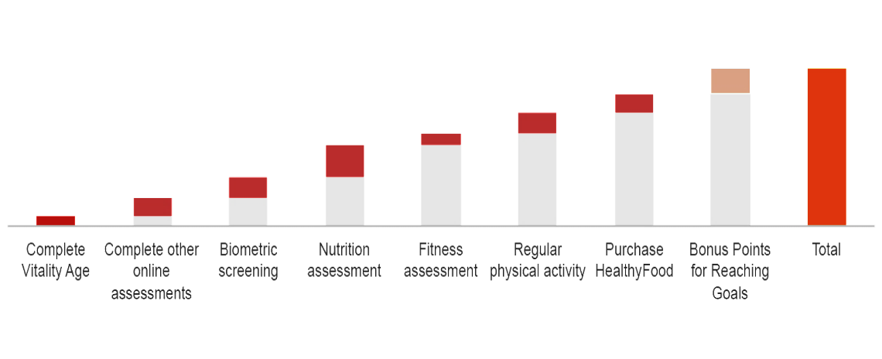

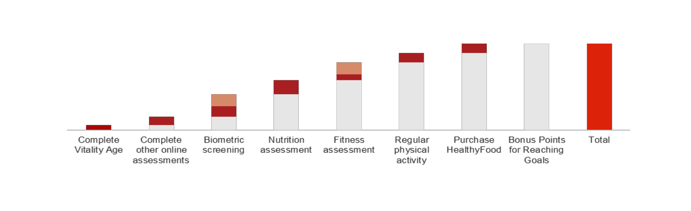
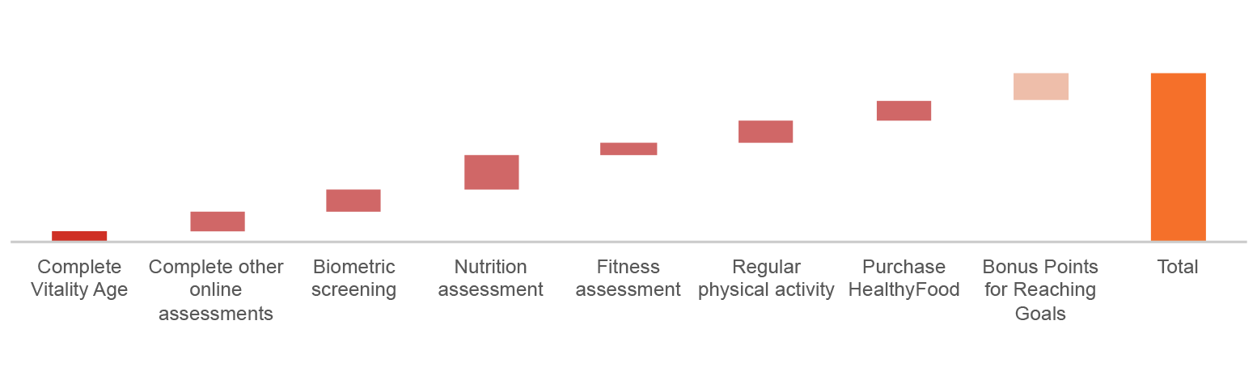
Health - Living the Vitality Program
Importantly, the journey to a top status is not dependent on a person’s initial health status
All members start at the same level each year regardless of health status
Members receive bonus points on completion of goals linked to specific risk factors
Status:
GOLD
Example of a less healthy person
Members enjoy bonus points based on their level of fitness
Status:
GOLD
Example of a very healthy person

Slide 18

Conclusions:
Connecting lives - in the home, on the road and for a healthier life
Technological changes will produce an epochal change in our industry
Connectivity and data are transforming the nature of our relationships with our customers
We have the opportunity for our industry to generate greater value for society through innovation that helps reduce risks through prevention

Slide 19
Serbia
CYBER RISK
XV INTERNATIONAL SYMPOSIUM
Zlatibor, 18-21. maj 2017.

Slide 20

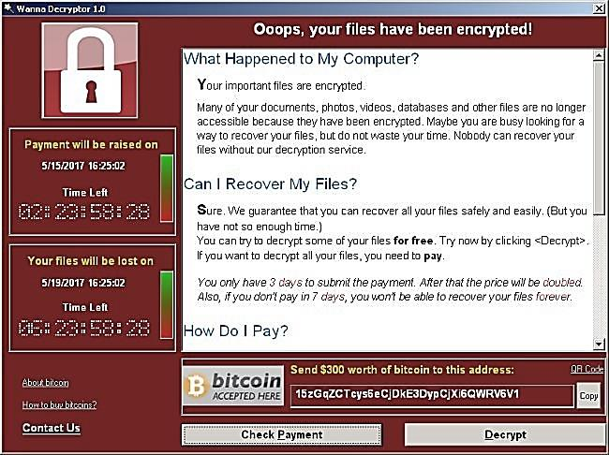
WannaCry
Global cyber-threat
?
The virus in effect holds the infected computer hostage and demands that the victim pay a ransom in order to regain access to the files on his or her computer.
The biggest problem with such ransomwares is that there is no well-known way to deal with it; even paying the ransom cannot guarantee that the files will be recovered.
What is Ransomware?
As the name suggests, it's the blocking or encrypting of one's files and then being asked for a ransom to decrypt those locked files. A new ransomeware called 'Wannacry' or 'Wannacrypt' has attacked a few big countries and created havoc by targeting sensitive industries like healthcare.
The biggest threat with 'Wannacry' is that it's more than just a ransomware; it can also be classified as a worm. Being a worm, the ransomware has the ability to spread to different systems running on the same LAN network or even spread through emails.

Slide 21


Cyber risk
Coverage
MAIN INSURED PERILS
Computer Malicious Act
Computer Malware
Human Error
Theft of Data
Denial of Service Attack
Damage to Third Party Property (Network Security Liability module only)
Loss, theft, disclosure of or damage to;
Confidential Information
Personally Identifiable Information
BASIC COVERAGE
Loss or theft of Data (1st Party)
Confidentiality Breach (3rd Party)
Privacy Breach incl. Notification (1st Party)
Privacy Breach (3rd Party)
PCI DSS (1st Party)
Network Security Liability (3rd Party)
MODULAR EXTENSIONS
Business Interruption (1st Party)
Cyber Extortion (1st Party)
Reputational Risk (1st Party)
Media Liability (3rd Party

Slide 22

Thank you for your attention
Innovation is the only way to win!
Steve Jobs

