Slide 1
15th Annual International Symposium on Insurance
May 20, 2017
Malcolm Campbell, Immediate Past President
International Actuarial Association

Slide 2

The Profession, the IAA and Beyond
The profession and where it is going
The IAA: past, present and future
What does it mean for actuaries?

Slide 3
Change Drivers
Technology
Information
Business complexity
Globalization
Regulation

Slide 4
Some of the Challenges Facing the Actuarial Profession Today
Negative interest rates
Major world demographic/
economic changes
Products, distribution and processes challenges
Customer information ‘mining’ and “big data”
Global regulation and supervision
Rapid changes in the ways people do business
Affinity groups
Business optimisations and risk management

Slide 5
A Vision for the Profession
Actuaries apply unique skills and a professional approach to solving complex problems, advising on future risks, opportunities and options, across diverse fields and industries

Slide 6
Unique Skills
Evaluate and manage risk and opportunity
Apply analytical, statistical and mathematical skills to financial and business problems
Solve complex problems using mathematics, probability and the time value of money
Perform in depth economic and financial analysis
Understand and communicate intricate financial concepts
Ability to think strategically

Slide 7


The IAA

Slide 8
History of the IAA
Founded in 1895 as continuation of the
Comité Permanent des Congrès d’Actuaires
Renamed IAA in 1968
Restructured in 1998 – creating a single, stronger unified framework ensuring unity of direction and efficient coordination with respect to issues of a world-wide nature

Slide 9
The IAA’s Membership in 1998

Slide 10
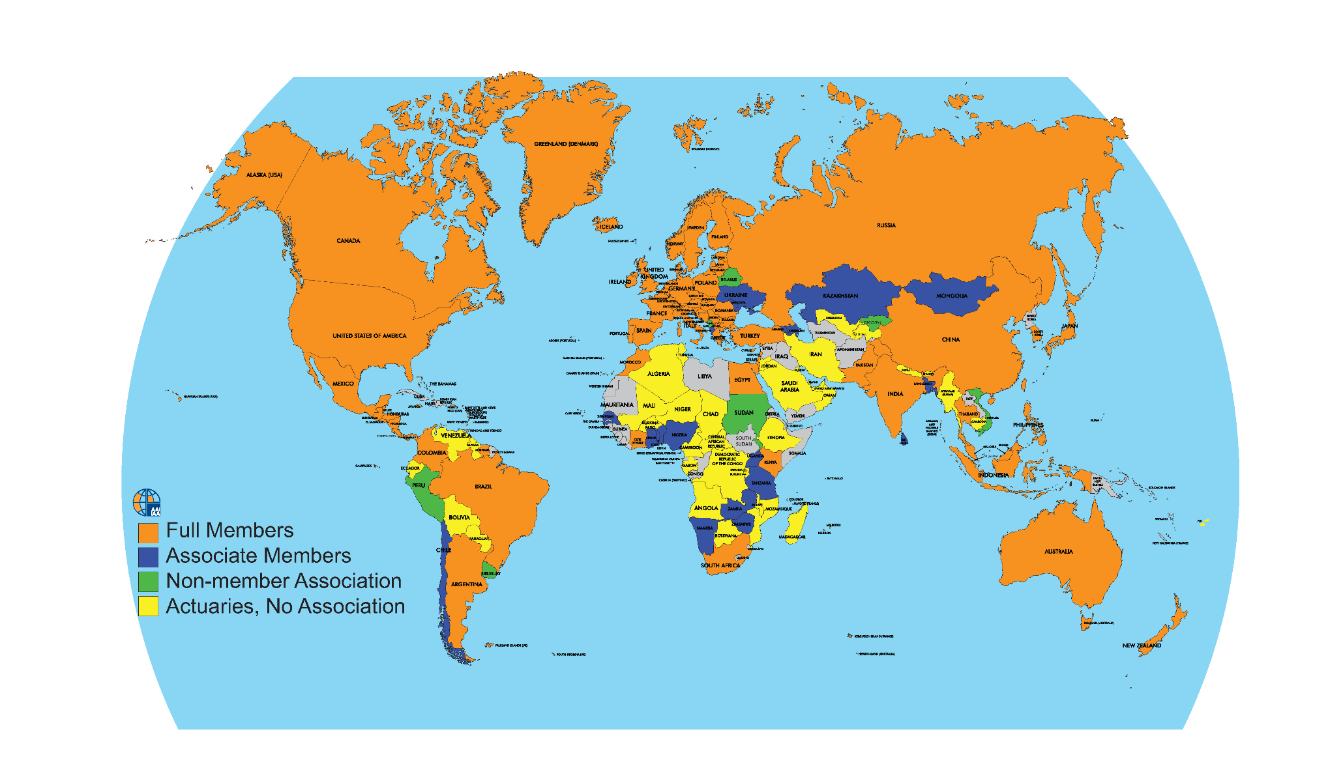
The IAA’s Membership in 2017

Slide 11




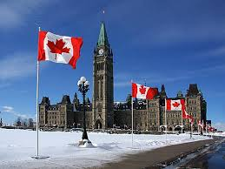


The IAA: An Association of Associations
Represents 60,000+ actuaries in
108+ countries
Encourages the development of a
global profession
7 Sections
5,000+ Section members
Formed in Switzerland
Based in Canada
800+ volunteers
Newest members: Turkey; Central America
Notes:
Worldwide association of professional actuarial associations

Slide 12
Our Vision
Our Mission
Be recognized worldwide as a major player in the decision-making process within the financial services industry…
Represent the actuarial profession and promote its role, reputation and recognition…
Contribute to the well-being of society as a whole
Promote professionalism, develop education standards and encourage research…

Slide 13
Our Objectives
Develop Relationships with key international audiences
Support the profession’s development, organization, and promotion
Expand the scientific knowledge and skills of the actuarial profession
Provide a forum for discussion
Encourage sound practice and education standards
Improve recognition of the actuarial profession (branding)
Notes:
SO 1:
Strengthening our relationships with relevant supranational organizations
Providing actuarial input on matters of importance
Working closely with the IAIS in support of the development of global capital standards (2014-16)
Working on inclusive insurance markets project with IAIS (also SO 2)
Working with IASB on topics relating to IFRS 17 Insurance Contracts
SO 2:
Two new working groups: Banking and Big Data
Accessible intellectual capital project
Risk Book
Educational Monographs on Risk Adjustment and Pension Funding
Papers on retirement ages and long-term care
Section Webinars and Colloquia
SO 3:
New syllabus for approval in 2016
Continuing Professional Development Requirements
3 ISAPs adopted, 2 on the Cape Town Council agenda for Adoption, 3 more under development
SO 4:
Financial assistance fund
Regional subcommittees: Asia, Latin America, Africa, Eurasia and the Middle East
Regional meetings
Actuaries Without Borders
SO 5:
Presidents’ Forum: held twice a year in conjunction with IAA meetings
Section webinars
Organizing/promoting International Congress of Actuaries : next one in Berlin June 4-8, 2018
Section Colloquia planned for 2017: PBSS Colloquium: Cancun, Mexico – 4-7 June; ASTIN/AFIR Colloquium: Panama City, Panama – 20-24 August; Life Colloquium: Barcelona, Spain – 23-25 October
SO 6:
Hired branding consultant
Important topics for discussion in Cape Town:
Council and Presidents’ Forum: Branding policy and actuarial profession brand statement (for use by the IAA)
Branding & Communications Subcommittee: Branding specification (for use by the IAA) and toolkit (for member associations)

Slide 14



















Our Partners, Observers, and other relationships
Formal
Informal
Notes:
Partners include important institutions that especially concern themselves at the international level with matters of concern to actuaries.
Observers: Public, academic or industry institutions of relevant interest for the global actuarial profession, particularly those active at international, supranational or regional level, that share IAA’s intent of enhancing communications, liaison, exchanges and strategic support
Patrons: Organizations that provide regular financial support to our volunteers who are developing the body of knowledge of actuarial science, enhancing the quality of services and the professional standards

Slide 15




How We Communicate
Distribution lists, conference calls, webinars
Annual Report and Newsletters
News Releases: to inform external audiences of important IAA initiatives
Social Media:
IAA Members’ Website contains:
Actuarial E-Library
International Events Calendar

Slide 16
Sections
AFIR
Actuarial Approach for Financial Risks
ASTIN
Actuarial Studies in Non-Life Insurance
AWB
Actuaries Without Borders
IAAHS
Health
IAALS
Life
IACA
International Association of Consulting Actuaries
PBSS
Pensions, Benefits, and Social Security

Slide 17
The IAA Sections’ Activities
Colloquia
Meetings to discuss research and its application
Shorter events focused on topics
of current interest
Webinars
Other events
Lectures and smaller meetings
ASTIN Bulletin
Other research papers
Publications
Promotion of research
Prizes
Networking/ discussion groups
E- based access to knowledge database
Virtual learning
Knowledge systems

Slide 18
Looking Forward
We need to:
Influence change
Look for new areas to apply our skills
Further develop the intellectual capital of the profession
Further develop our brand image

Slide 19
The Actuary

Slide 20
What Skills are Employers Looking For ?
Commercial and softer skills
  Communication
  Stakeholder management +
  teamwork
  Consulting
  Project Management
  Delivery
  New business
  Innovation
  Leadership + influence + people
Personal attributes
  Professionalism
  Appetite to continue to develop
  Energy
  Persistency

Slide 21
What does this mean for actuaries?
Develop competence (CPD), in particular “softer skills”
Seek new areas to apply skills
Keep informed
Be seen to be professional
Think of how one communicates well

Slide 22

Thank you
Moving the profession forward internationally
actuaries.org

